Slide 1

Budget Committee Meeting
S T . J O H N S C O U N T Y A I R P O R T A U T H O R I T Y
Second Public Hearing · FY 2026-27 Final Budget
Tuesday, September 15, 2026 · 8:00 AM Airport Conference Center
Courtney K. Pittman, Executive Director · Connie Worley, Financial Controller

Slide 2

Agenda
S E C O N D P U B L I C H E A R I N G
1
Pledge of Allegiance
Two final adoptions today
Resolution 2026-17
Final levying of ad valorem taxes. The proposed rate is 0.0000 mills, which does not exceed the rolled-back rate.
Resolution 2026-18
Final adoption of the annual budget of revenues and expenditures, which is then attached to the minutes of this meeting.
Millage must be taken up and adopted before the budget. Public comment is invited on each.
2
Opening Remarks
Millage
Discussion · public comment · discussion and comments
3
Final Adoption — Resolution 2026-17
Final millage rate
4
Proposed Budget
Staff presentation · public comment · discussion and comments
5
Final Adoption — Resolution 2026-18
Final FY budget
6
Next Meeting and Adjournment
October 14, 2026 at 9:00 AM
7
St. Augustine Airport | Budget Committee Meeting | September 15, 2026
Order of business

Slide 3
Millage
Discussion, public comment, and final adoption
01
Discussion of the millage rate by the Authority
Public comment
Discussion and comments
Final adoption — Resolution 2026-17

Slide 4
Final Millage Rate
M I L L A G E
0.0000
Final millage rate, in mills
Does not exceed
The proposed rate does not exceed the rolled-back
rate
$0
Ad valorem revenue in the final budget
What the Board is being asked to do
Why the rate is zero
The Authority does not propose to levy ad valorem taxes for the coming fiscal year. The budget is funded from lease revenue, fuel service revenue, operating agreements, investment income, and state and federal grants — with no property tax support.
Announce the rolled-back and proposed rates
Discuss the millage rate
Receive public comment
Discuss and comment
Adopt Resolution 2026-17 — final millage rate
This is the second and final public hearing. The rate adopted this morning is the final millage rate for Fiscal Year 2026-2027.
St. Augustine Airport | Budget Committee Meeting | September 15, 2026
Resolution 2026-17

Slide 5
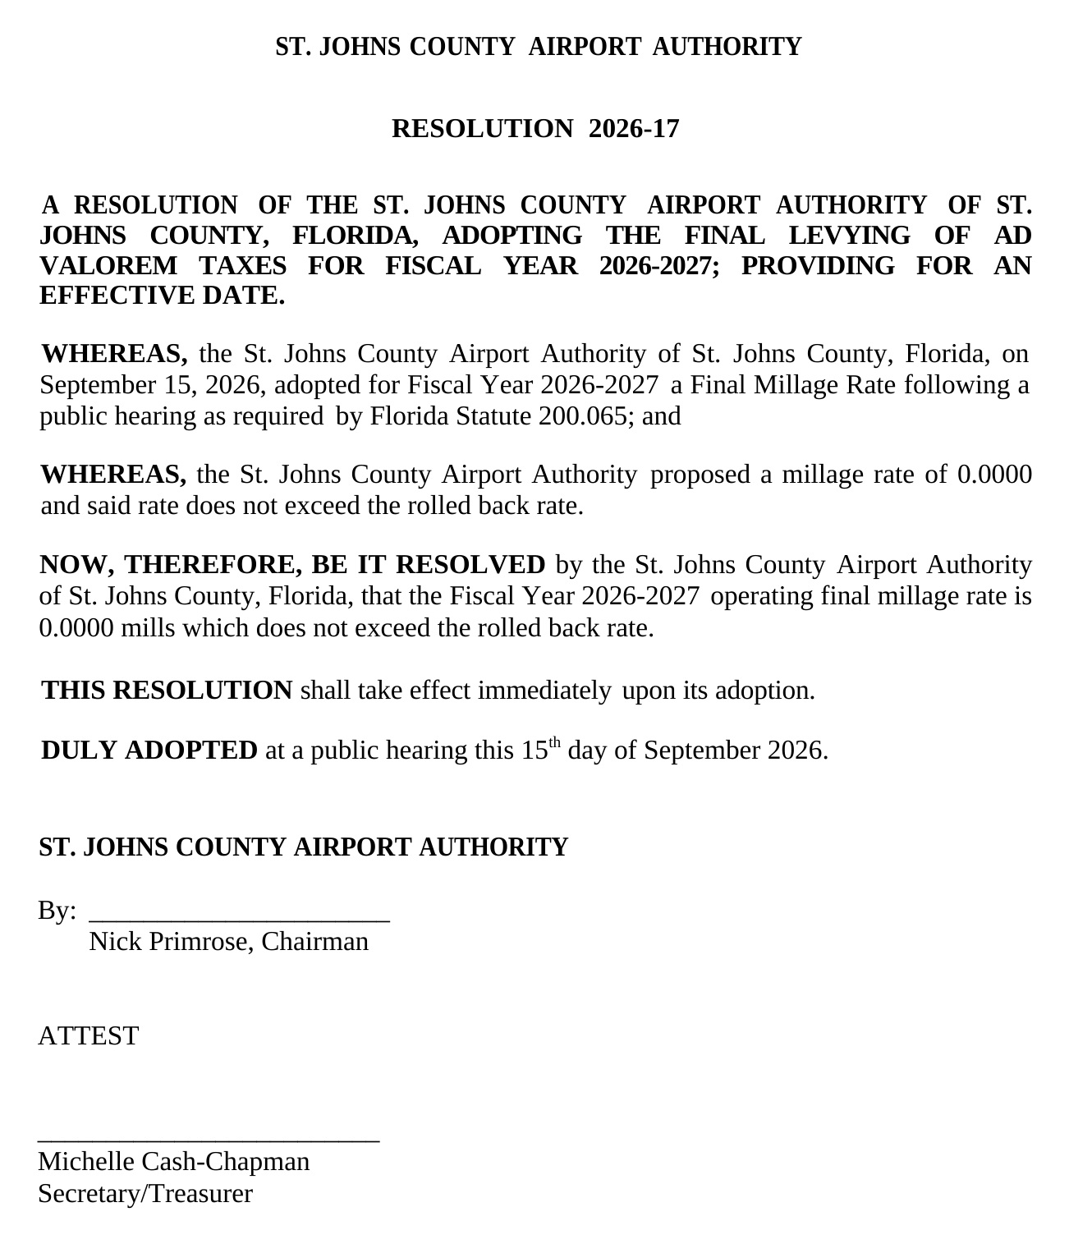
Resolution 2026-17 · Final levying of ad valorem taxes

Slide 6
Proposed Budget
Staff presentation, public comment, and final adoption
02
Proposed budget — staff
Public comment
Discussion and comments
Final adoption — Resolution 2026-18

Slide 7
FY 2026-27 at a Glance
P R O P O S E D B U D G E T
$6,000,513
Total operating revenues — up
$121,963 over the FY 25/26 budget
$4,750,558
Total operating expenses — up
$393,965
$740,354
Operating income before debt service
and depreciation
$12,774,022
Total anticipated capital program
activity
How the year is built
 | FY 26/27 Final | Note
Gross profit after cost of fuel | $5,490,912 | Cost of fuel budgeted at $509,601, down $165,793 from the FY 25/26 budget
Operating income before DS and depreciation | $740,354 | Down $106,208 against the FY 25/26 budget
Total non-operating income | $11,790,501 | Driven by $11,670,141 in operating grants
Depreciation | $5,200,000 | Non-cash
Net income | $7,330,855 | Reflects grant-funded capital activity, not operating margin
Capital outlay funded by the Authority is $933,745, separate from the grant-funded capital program above.
St. Augustine Airport | Budget Committee Meeting | September 15, 2026
Budget summary

Slide 8
BOARD FOLLOW-UP
Lease revenue by category
Category | FY 26/27 | Example tenants
Major Lease Revenue | $1,865,254 | Atlantic, Northrop Grumman
T-Hangars / Box / L-Hangars | $1,388,176 | Various tenants
Commercial Tenant Revenue | $565,892 | First City & Old City Helicopters, Hangar One, Rivkin, SE Aero, Roberts, Old City Jets, FL Flyers, Volato
Other Lease Revenue | $539,711 | Land: Military Affairs, Nimbus, SBA Tower, Wings & Wheels, REMAX | Office: FL Flyers, FACT, R. Thousand, P. Wagstaff, Aeropro
Corporate Hangar Revenue | $232,800 | SJCSO, Infinity, Ring Power
Residential & Tie-Down | $18,000 | Residential: Connel | Tie-down: P. Wagstaff, K. Al Shemree
Total Lease Revenue | $4,609,833
St. Augustine Airport | Budget Committee Meeting | September 15, 2026
Board follow-up

Slide 9
BOARD FOLLOW-UP
Professional services by category
Category | FY 26/27 | What it covers
Legal Services (incl. public records) | $413,466 | General counsel, litigation, and public-records requests
Engineering Services | $160,000 | Advanced Air Mobility alternative analysis (board-directed)
Consulting Services | $85,276 | Economic development and grant assistance
LEO & ARFF Personnel | $78,000 | Study ($15K) and third-quarter implementation ($63K)
Appraisal Services | $60,000 | Newly developed parcels and major-tenant lease renewals
Accounting & Auditing | $53,560 | Annual financial audit and accounting support
HR Services | $40,000 | Human-resources support
Court Reporting (Board) | $7,000 | Board meeting reporting
Total Professional Services | $897,302
St. Augustine Airport | Budget Committee Meeting | September 15, 2026
Board follow-up

Slide 10

St. Augustine St. Johns County Airport Authority
FY 26/27 Budget - Final September 15, 2026
 | FY 25/26 YE Forecast | FY 25/26 Budget | FY 25/26 Budget Variance | Adjustments | FY 26/27 Proposed Budget | FY 26/27 vs FY 25/26 Budget Variance
Operating Revenues Fuel Service Revenue | 1,045,541.22 | 1,192,980.54 | (147,439.33) | (200,000) | 1,036,797 | (156,184)
Lease Revenue | 4,345,587.06 | 4,332,641.18 | 12,945.88 | - | 4,609,833 | 277,192
Operating Agreements | 320,126.79 | 317,928.12 | 2,198.67 | - | 320,587 | 2,659
Other Operating Revenue | 34,018.13 | 35,000.05 | (981.92) | - | 33,296 | (1,704)
Total Operating Revenues | $ 5,745,273 | $ 5,878,550 | $ (133,277) | $ (200,000) | $ 6,000,513 | $ 121,963
Cost of Goods Sold Total for 400-400 Cost of Fuel | 677,250 | 675,394 | 1,856 | - | 509,601 | (165,793)
Total COGS | 677,250 | 675,394 | 1,856 | - | 509,601 | (165,793)
Gross Profit | $ 5,068,023 | $ 5,203,156 | $ (135,132) | $ (200,000) | $ 5,490,912 | $ 287,756
Operating Expenses Personnel & Benefits | 1,864,501 | 2,002,718 | (138,218) | 108,326 | 2,144,365 | 141,647
Professional Services | 862,543 | 700,600 | 161,943 | (13,040) | 897,302 | 196,702
Airline Operations/Badging | 4,554 | 3,000 | 1,554 | - | 4,554 | 1,554
Business Travel & Training | 23,923 | 46,950 | (23,027) | 10,000 | 55,150 | 8,200
Technology | 58,615 | 60,700 | (2,085) | - | 63,700 | 3,000
Utility Services | 208,935 | 234,500 | (25,565) | - | 219,800 | (14,700)
Insurance | 447,457 | 464,225 | (16,768) | 3,791 | 451,248 | (12,977)
Repairs & Maintenance | 321,775 | 323,300 | (1,525) | 5,000 | 345,580 | 22,280
Promo, Dues & Memberships | 22,368 | 20,500 | 1,868 | - | 18,000 | (2,500)
Government Fees & Assessments | 401,196 | 315,200 | 85,996 | - | 359,308 | 44,108
Office Expenses & Fees | 32,418 | 30,900 | 1,518 | - | 48,550 | 17,650
Operating Expense | 126,006 | 154,000 | (27,994) | - | 143,000 | (11,000)
Contract/Temp Labor | - | - | - | - | - | -
Total Operating Expenses | 4,374,291 | 4,356,593 | 17,698 | 114,077 | 4,750,558 | 393,965
Operating Income before DS and Depr | $ 693,732 | $ 846,562 | $ (152,831) | $ (314,077) | $ 740,354 | $ (106,208)
St. Augustine – St. Johns County Airport Authority • FY 26/27 Budget - Final • September 15, 2026

Slide 11
St. Augustine St. Johns County Airport Authority
FY 26/27 Budget - Final
September 15, 2026
FY 25/26 YE
Forecast
FY 25/26
Budget
FY 25/26 Budget Variance
Adjustments
FY 26/27
Proposed Budget
FY 26/27 vs FY
25/26 Budget Variance
Non Operating Income
Operating Grants | 1,486,442 | 4,297,028 | (2,810,587) | - | 11,670,141 | 7,373,113
Investment Income | 147,687 | 177,300 | (29,613) | - | 120,000 | (57,300)
Other Non Operating Income | 270 | 360 | (90) | - | 360 | -
Total Non Operating Income | 1,634,398 | 4,474,688 | (2,840,290) | - | 11,790,501 | 7,315,813
Non Operating Expense | - | - | - | - | - | -
Total Non Operating Expenses | - | - | - | - | - | -
Income Before Depreciation | $ 2,328,130 | $ 5,321,251 | $ (2,993,121) | $ (314,077) | $ 12,530,855 | $ 7,315,813
Depreciation Expense | 4,925,650 | 5,200,000 | (182,900) |  | 5,200,000 | -
Net Income | $ (2,597,519) | $ 121,251 | $ (2,810,220) | $ (314,077) | $ 7,330,855 | $ 7,209,605
St. Augustine – St. Johns County Airport Authority
FY 26/27 Budget - Final
September 15, 2026

Slide 12
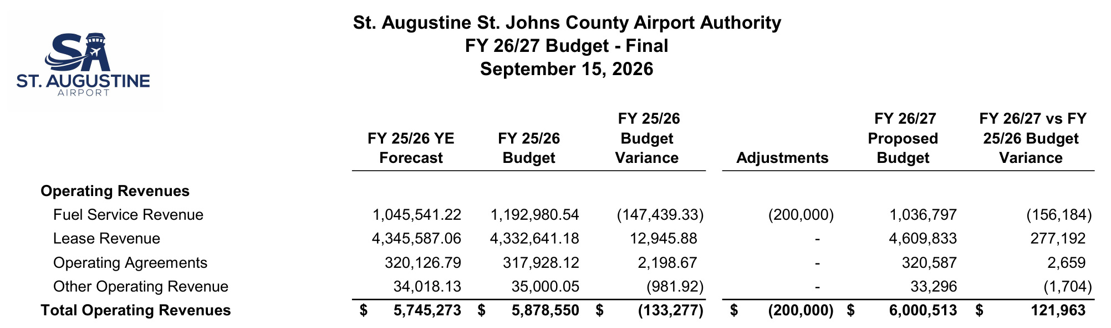
Operating revenues · FY 26/27 final against FY 25/26

Slide 13
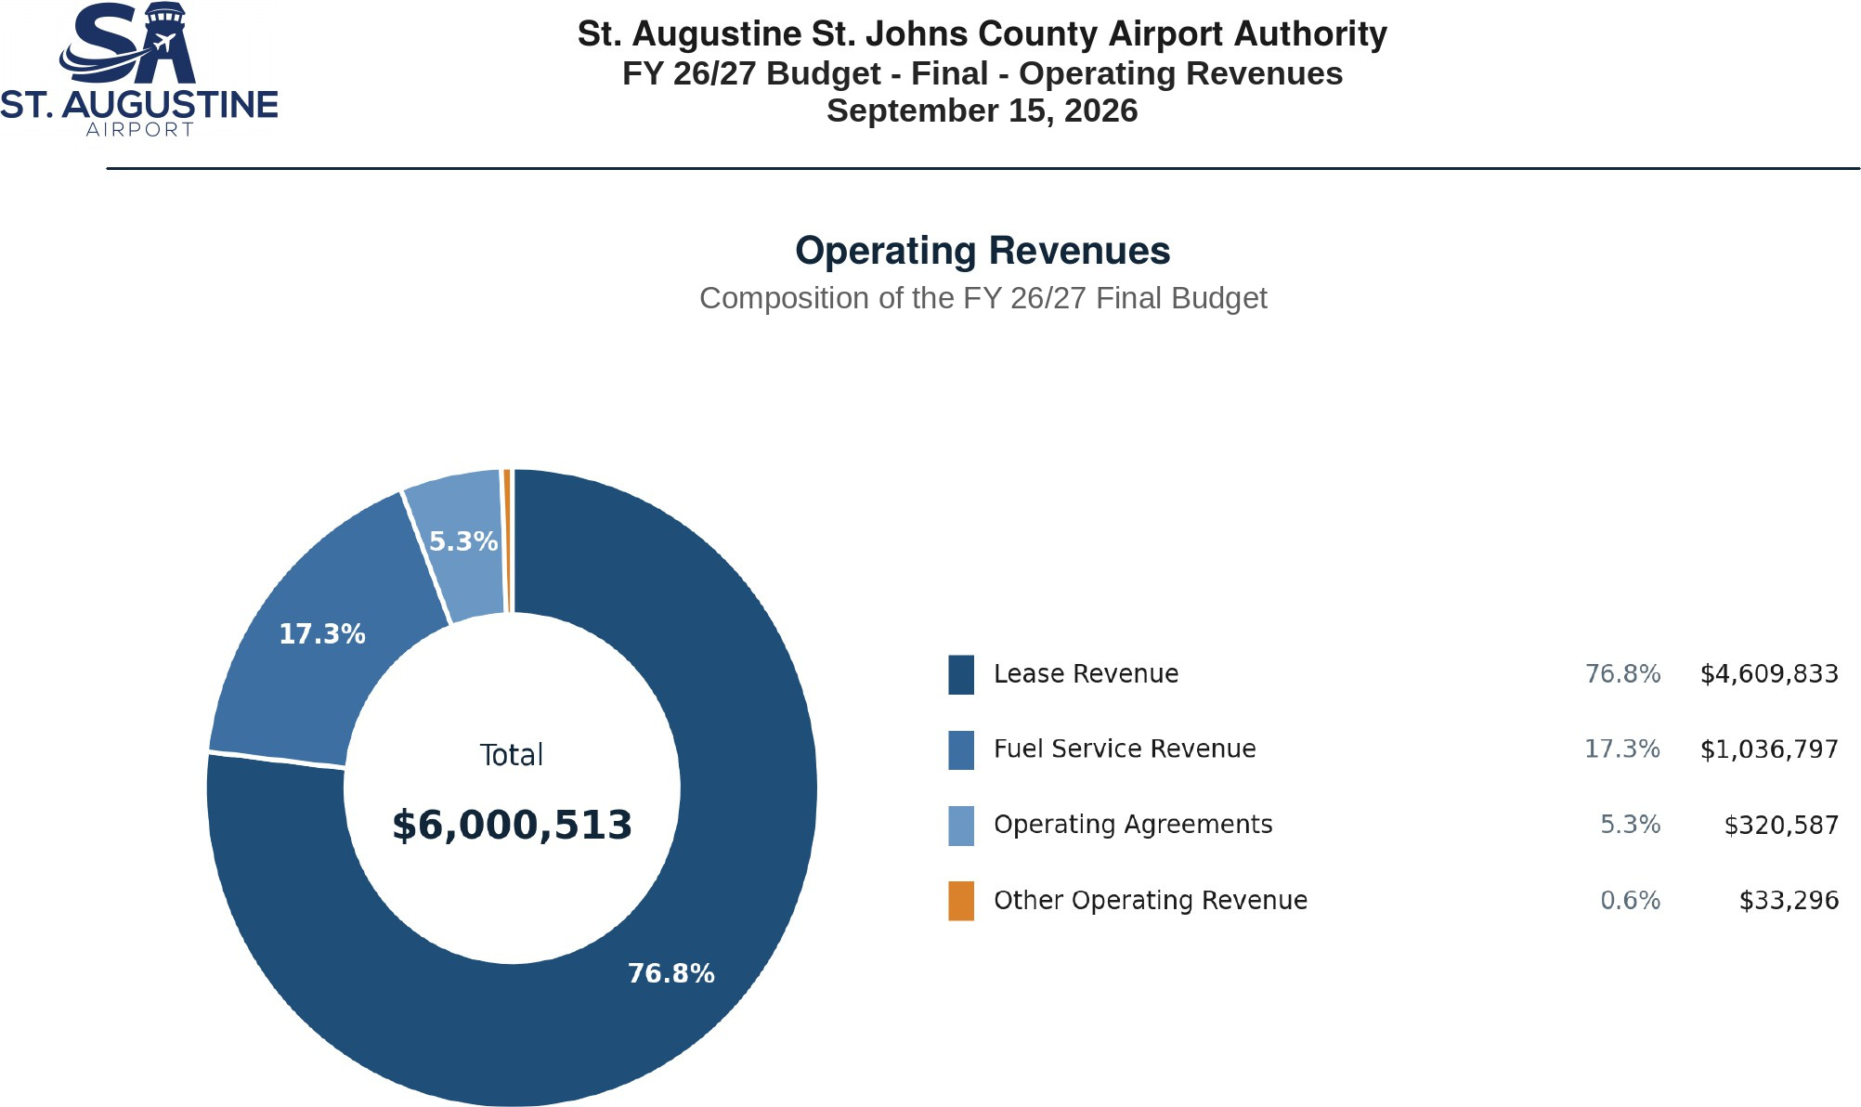
Operating revenues · Composition of the final budget

Slide 14
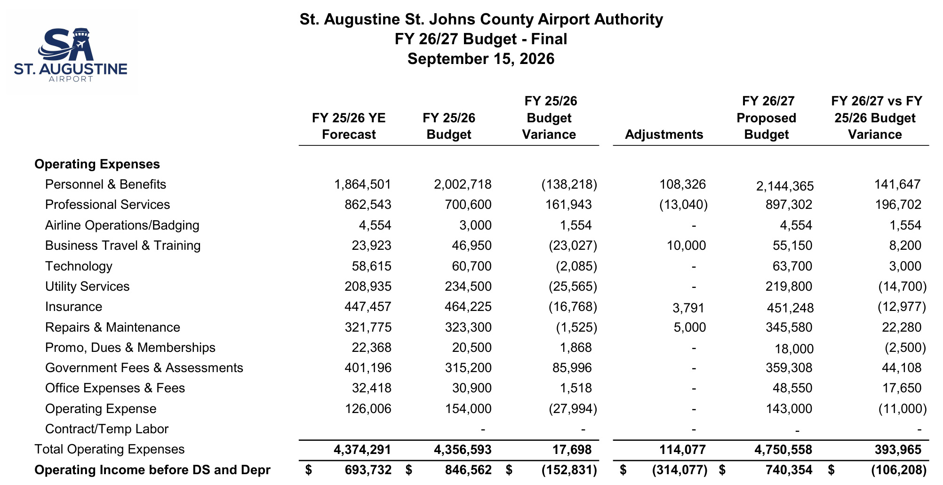
Operating expenses · FY 26/27 final against FY 25/26

Slide 15
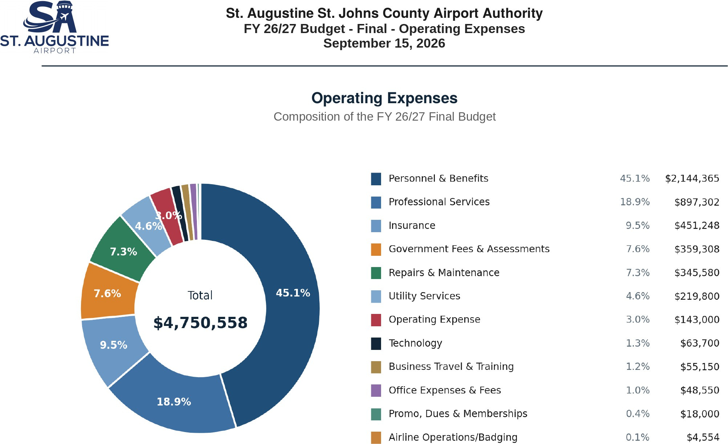
Operating expenses · Composition of the final budget

Slide 16
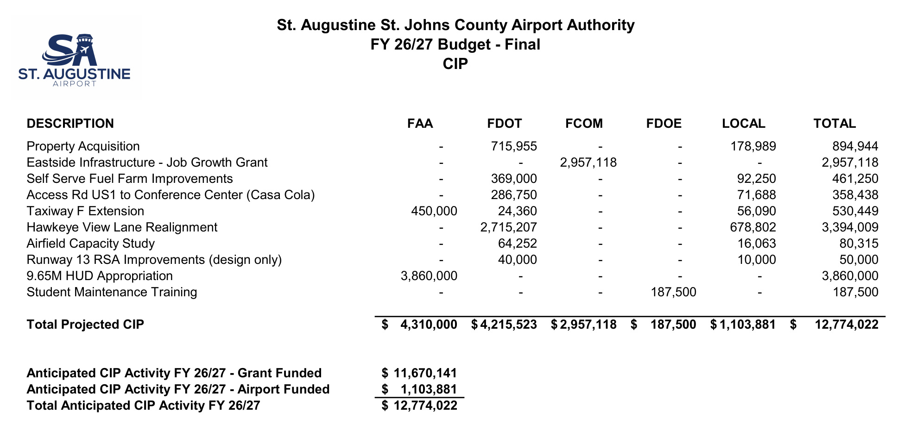
Capital Improvement Program · Anticipated FY 26/27 activity by funding source

Slide 17
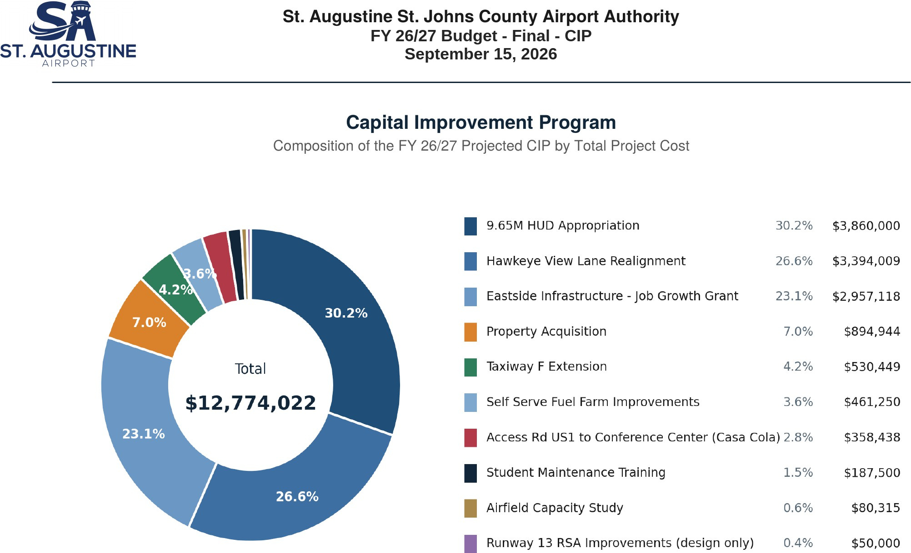
Capital Improvement Program · Composition by total project cost

Slide 18
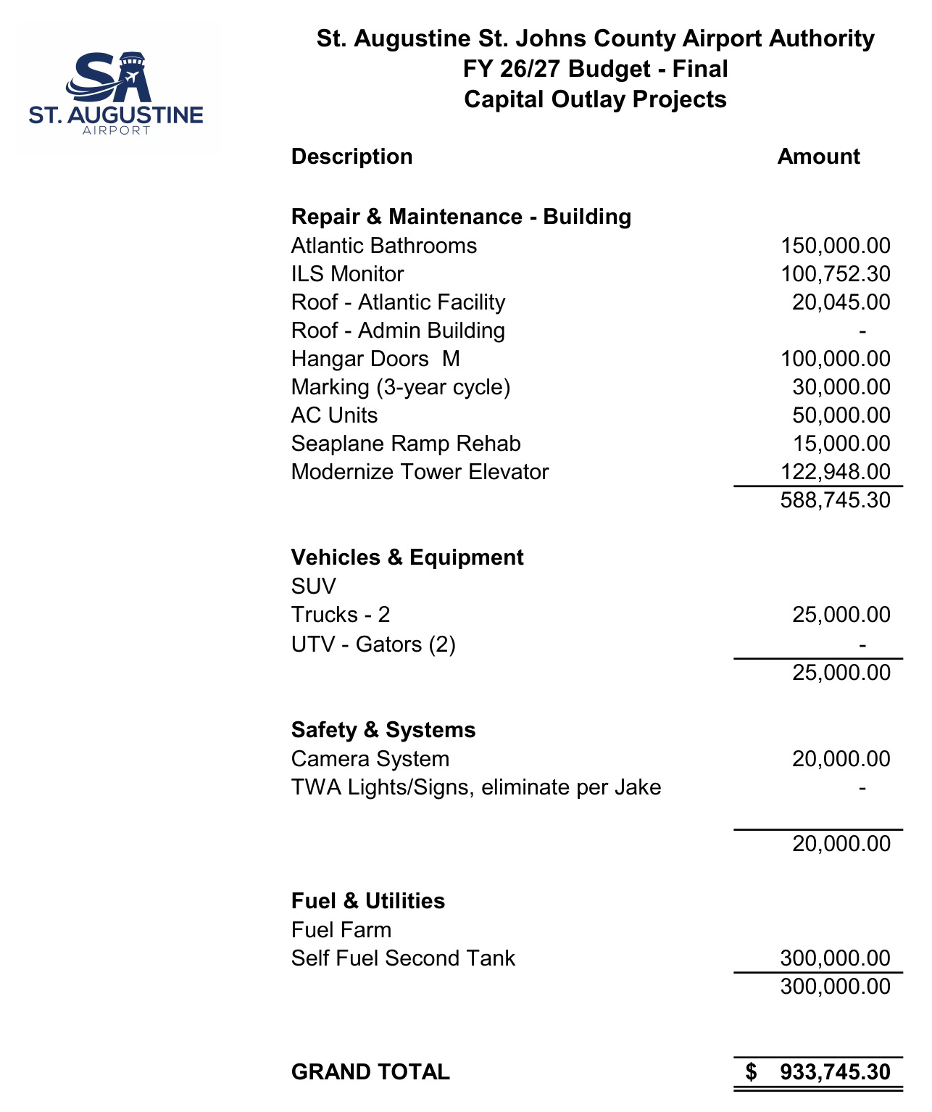
Capital outlay · Authority-funded capital projects adopted for FY 26/27

Slide 19
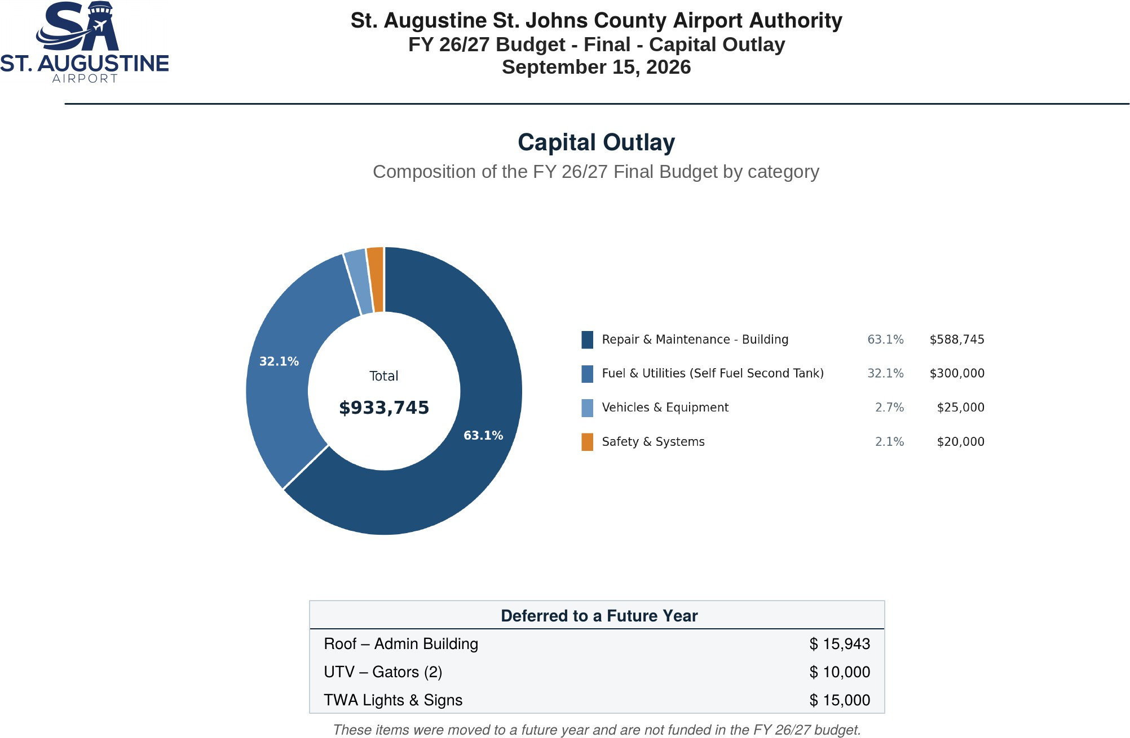
Capital outlay · Composition by category, and items deferred to a future year

Slide 20
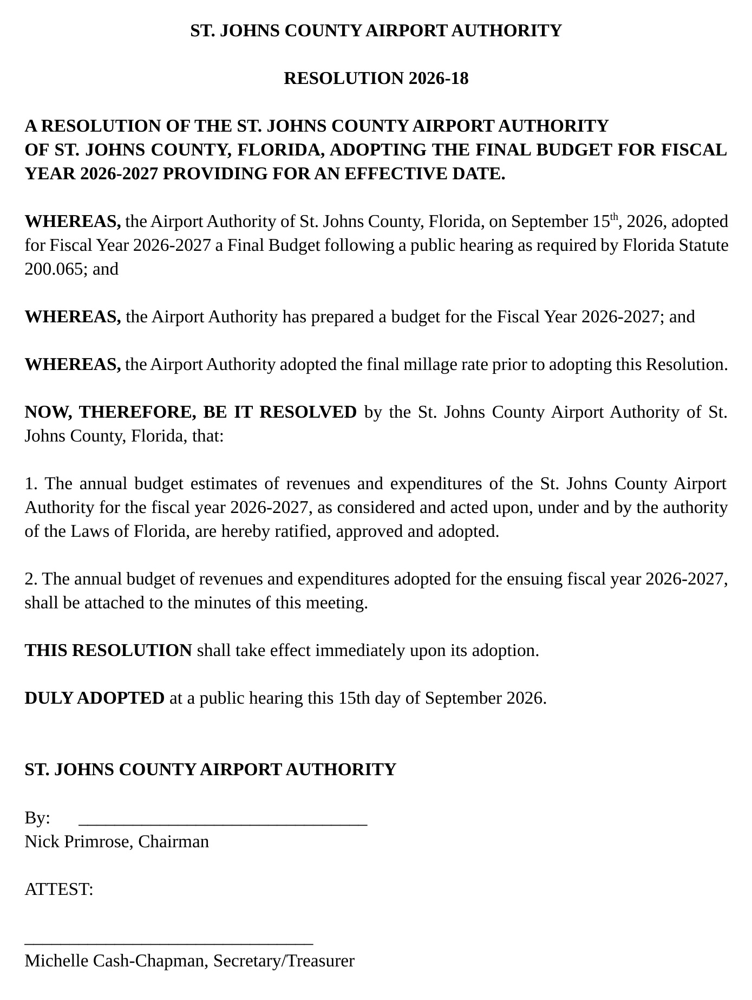
Resolution 2026-18 · Final adoption of the annual budget

Slide 21
Regular Board Meeting
N E X T M E E T I N G A N D A D J O U R N M E N T
October 14, 2026 · 9:00 AM First regular Board meeting of Fiscal Year 2026-2027
Today's adoptions are final. The adopted millage rate and budget take effect with the start of Fiscal Year 2026-2027 on October 1, 2026.
Adjournment

