Slide 1



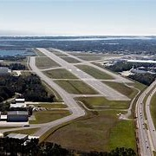
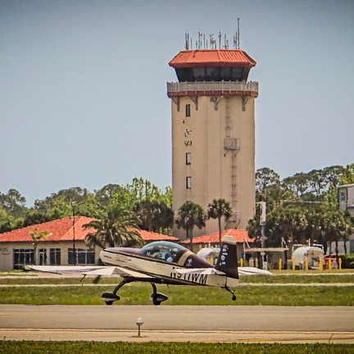
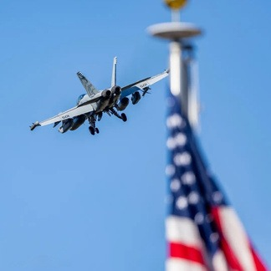


BOARD MEETING
AGENDA
July 15, 2026
Info@SGJ-Airport.com
www.sa-airport.com
Notes:
Board Meeting Agenda — July 15, 2026. St. Augustine Airport. Info@SGJ-Airport.com · www.sa-airport.com

Slide 2
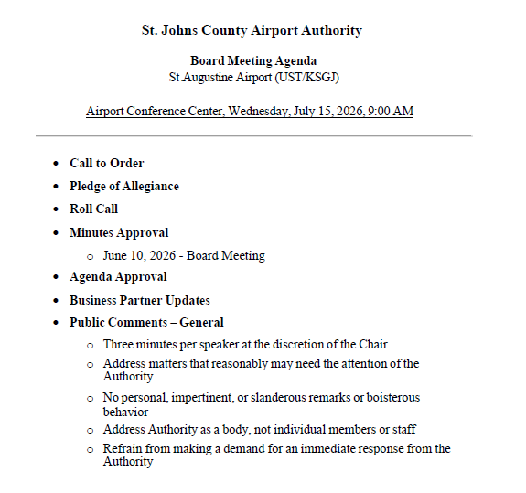

Slide 3
Unfinished Business
Notes:
Unfinished Business

Slide 4









BOARD ACTION ITEM • PERSONNEL
Executive Director's Contract
The Executive Director's employment contract is presented for the Board's review, discussion, and vote.
→
→
STEP 1
STEP 2
STEP 3
Review
Discussion
Vote
Examine the proposed terms and conditions of the agreement.
Deliberate on the terms and raise any questions or revisions.
Formally act to approve, amend, or defer the contract.
KEY CONTRACT ELEMENTS UNDER REVIEW
Contract
Term
Compensation
Benefits
Duties &
Authority
Performance
Evaluation
Termination
& Severance
Notes:
Action item: the Executive Director's employment contract is presented for the Board's review, discussion, and vote. Steps: (1) review the proposed terms; (2) discuss and raise questions or revisions; (3) vote to approve, amend, or defer. Key elements under review include contract term, compensation, benefits, duties and authority, performance evaluation, and termination and severance provisions.

Slide 5

PROPERTY DISPOSITION | BOARD BRIEFING
151 Gun Club Road
Options for Board Consideration
1. Repossession
2. New Agreement
3. Ratify Existing Lease
Future Disposition & Management • Prepared for Board Consideration
Notes:
Purpose: present three options for the future disposition and management of 151 Gun Club Road for Board discussion and direction.

Slide 6

PURPOSE
THREE OPTIONS FOR CONSIDERATION
Charting the property's path forward
1
Repossession of the Facility
Regain possession and operational control.
The following options are presented for Board consideration regarding the future disposition and management of the property located at 151 Gun Club Road.
2
Enter Into a New Agreement
Reset terms to current objectives and fair value.
Each option is outlined with the key considerations for the Board to weigh in reaching a decision.
3
Ratify the Existing Lease
Maintain continuity through June 1, 2029.
Notes:
This briefing outlines three options and the considerations associated with each, to support Board discussion.

Slide 7




1
OPTION 1
Repossession of the Facility
CONSIDERATIONS
Terminate the Agreement
Regain Control
End the current occupancy.
Regain possession and operational control of the facility.
Evaluate Future Use
Assess Implications
Assess future use, redevelopment, or reissuance through a competitive solicitation.
Weigh the financial, operational, and legal implications of repossession.

Slide 8



2
OPTION 2
Enter Into a New Agreement
CONSIDERATIONS
Update the Terms
Fair Market Value
Establish terms that reflect the Authority's current operational and strategic objectives.
Review rental rates and financial considerations to ensure fair market value.
Strengthen Standards
Set Term & Renewals
Add performance, reporting, maintenance, insurance, and default provisions.
Establish an appropriate agreement term and any renewal options.

Slide 9



3
OPTION 3
Ratify the Existing Lease Through June 1, 2029
CONSIDERATIONS
Maintain Continuity
Preserve the Terms
Continue the current lease arrangement through its expiration.
Keep existing lease terms and conditions unless modified by Board action.
Enable Planning
Minimize Disruption
Allow additional time for long-term planning on the property's future use.
Reduce operational disruption while providing certainty to both parties.

Slide 10

OPTIONS AT A GLANCE
Weighing control, timing, and trade-offs
Repossession
New Agreement
Ratify Existing Lease
1
2
3
CONTROL
CONTROL
CONTROL
Full Authority control of the facility
Updated, negotiated terms with occupant
Status quo maintained under current terms
HORIZON
HORIZON
HORIZON
Opens new use or competitive re-solicitation
Resets the arrangement to current objectives
Runs through June 1, 2029
TRADE-OFF
TRADE-OFF
TRADE-OFF
Higher legal, financial & transition effort
Requires negotiation and fair-value review
Defers the long-term use decision
Notes:
Comparison of the three options across control, planning horizon, and key trade-offs.

Slide 11

STAFF RECOMMENDATION
Board Discussion
1 Repossession
2 New Agreement
Staff recommends that the Board discuss the options presented and provide direction on the preferred course of action for 151 Gun Club Road.
3 Ratify Lease
Notes:
Recommendation: Board discussion — staff seeks Board direction on the preferred option for 151 Gun Club Road.

Slide 12
BOARD ACTION ITEM • PERSONNEL
Director of Operations Salary
Staff requests that the Board vote to approve the proposed annual salary range for the Director of Operations position.
PROPOSED ANNUAL SALARY RANGE
$110,000 – $135,000
MINIMUM
MIDPOINT
MAXIMUM
$110,000
$122,500
$135,000
Starting point of range
Mid-range reference
Top of range
Requested Action: Board vote to approve a salary of $110,000 to $135,000 for the Director of Operations.
Notes:
Board action item: staff requests that the Board vote to approve an annual salary range of $110,000 to $135,000 for the Director of Operations position. The midpoint of the range is $122,500. Requested action: a motion to approve the salary range as presented.

Slide 13
New Business
Notes:
New Business

Slide 14

BOARD BRIEFING · SECURITY REVIEW
Badge Policy Update
Our standing guest-badge policy is out of step with every comparable Florida airport — and it is a security vulnerability we can close.
The ask: align guest access with our peers by moving to a tenant-escort model
Why us: the Authority is responsible for the overall security of the airport
Notes:
Lead with the ask. This is a recommendation deck: our guest badging is the one place we are more permissive than every comparable Florida airport, and it is a closable security gap.

Slide 15




WHY THIS IS IN FRONT OF YOU
Access control is our responsibility — and our first line of defense
The Authority owns the overall security of the airfield. Who we let behind the fence — and how we account for them — is the core of that duty. Today one policy leaves that duty weaker than it needs to be.
The gap
The benchmark
The fix
We issue standing guest badges (up to 2 per lessee) that give unvetted guests their own unescorted access.
Every Florida airport we reviewed handles guests by escort — no standing guest badge.
Adopt the peer escort model. Low cost, no equipment — a policy change we control.
St. Augustine Airport · St. Johns County Airport Authority
Badge Policy Update | 2 / 11
Notes:
Frame duty first, then gap/benchmark/fix. Boards act on clear responsibility + a low-cost fix.

Slide 16


THE FINDING
On guest access, we are the outlier
Us — St. Augustine Airport
Every Florida peer we reviewed
Standing guest badges
Escort model
Up to 2 per lessee. An unvetted guest can enter and move about the airfield alone, at any hour.
Guests are accompanied by a badged tenant who stays responsible — no standing credential is issued.
HANDLE GUESTS BY ESCORT — NOT STANDING BADGES
Jacksonville / Craig
Orlando Executive
Miami Executive
Opa-locka Exec
Fort Lauderdale Exec
Kissimmee Gateway
NW FL Beaches
Daytona Beach
Ormond Beach
St. Augustine Airport · St. Johns County Airport Authority
Badge Policy Update | 3 / 11
Notes:
Sharpen the contrast. We are alone in issuing standing guest badges; all nine peers escort.

Slide 17
COMPARISON CHART
What each Florida airport requires
Airport
Type
Guests
Must be a tenant?
Requirements
St. Augustine Airport (SGJ)
Part 139 · GA
Standing guest badges (2 / lessee)
Tenant or substantiated need
Photo ID + AOA training
Jacksonville Exec at Craig (CRG)
GA (JAA)
Escort — no standing badge
Tenant / operational need
ID + training + fingerprint & threat check
Orlando Executive (ORL)
Part 139
Escort — no piggybacking
Tenant / authorized signatory
ID + training + background check
Miami Executive (TMB)
GA (Miami-Dade)
Escort — tenant-responsible
Yes — via primary tenant
ID + ramp & security rules
Miami–Opa-locka Exec (OPF)
GA (Miami-Dade)
Escort — tenant-responsible
Yes — via primary tenant
ID + ramp & security rules
Fort Lauderdale Exec (FXE)
GA reliever
Escort — tenant-responsible
Tenant / sponsor
ID + badge; 24-hr on-site security
Kissimmee Gateway (ISM)
GA reliever
Escort — via FBO
Tenant-based
ID + badge (confirm details)
NW Florida Beaches Intl (ECP)
Part 139
Escort (rules & regs)
Tenant / Exec Director
ID + badge
Daytona Beach Intl (DAB)
Part 139
Escort — tenant-responsible
Tenant / operational need
ID + training + fingerprint/threat check
Ormond Beach Municipal (OMN)
GA (municipal)
Escort (typical)
Tenant / sponsor
Confirm with airport
Every peer handles guests by escort — St. Augustine is the only airport issuing standing guest badges.
“Escort” = guests accompanied by a badged tenant, no standing badge issued. “Confirm with airport” = detail not publicly published.
St. Augustine Airport · St. Johns County Airport Authority
Badge Policy Update | 4 / 11
Notes:
Peer policy comparison. Our row is highlighted and the guests cell flagged: we are the only airport issuing standing guest badges — everyone else escorts.

Slide 18



THE VULNERABILITY
Why a standing guest badge weakens security
Unvetted + unescorted
Diffuse, paper accountability
Off-hours exposure
A guest badge hands independent, repeat airfield access to someone who may have had little or no vetting — with no one required to be present.
Once the badge is handed over, the sponsoring tenant is no longer present. Accountability exists on paper, not in real time.
Our field is quietest at night and on weekends — exactly when a standing-badge holder can operate unobserved.
956+
badges are in circulation today. Every one is a live key to the airfield we must vet, track, and be able to account for.
St. Augustine Airport · St. Johns County Airport Authority
Badge Policy Update | 5 / 11
Notes:
The mechanism: unvetted+unescorted access, paper-only accountability, and worst exposure at odd hours — against a backdrop of 956+ live credentials.

Slide 19



WHAT IS AT STAKE
What the exposure looks like
Illustrative categories of risk that unescorted, unvetted airfield access opens up — not incidents at our field, but exposures the current policy leaves open.
Aircraft theft or tampering
Unauthorized airside entry
Diversion & smuggling
Liability & reputation
Based and transient aircraft sit unattended. Insider access to the ramp is how aircraft get stolen or sabotaged.
A standing badge is a repeatable key past the fence for someone we never fully vetted.
Unwatched airfield access is a known vector for moving contraband, cargo, or people.
If a badged guest causes an incident, the Authority owns the security failure — and the headlines.
St. Augustine Airport · St. Johns County Airport Authority
Badge Policy Update | 6 / 11
Notes:
Grounded, not alarmist. These are the exposure categories the policy leaves open, clearly framed as illustrative rather than local incidents.

Slide 20




THIS IS NOT JUST OUR OPINION
Federal security authorities flag exactly this risk
Insiders are a top aviation threat
Small GA fields are especially exposed
TSA has characterized the insider threat — people using authorized access and knowledge to cause harm — as one of the greatest threats to aviation.
Federal reviewers note suspicious activity can go undetected at small general-aviation airports because few people are present at odd hours and surveillance is limited.
Loose credentials get exploited
Accountability is the standard
Insiders exploit loosely enforced policies; badge sharing and piggybacking are recognized warning signs. A real 2018 case saw a ground worker use insider access to steal and crash an aircraft.
The accepted access-control standard is to minimize credentials in circulation and retrieve, audit, and revalidate them — the opposite of proliferating standing guest badges.
Sources: U.S. Government Accountability Office and TSA reporting on airport access control and insider threat.
St. Augustine Airport · St. Johns County Airport Authority
Badge Policy Update | 7 / 11
Notes:
Third-party authority (GAO/TSA) makes the case credible and de-personalizes it. The 2018 aircraft-theft reference is the Sea-Tac Q400 event — a real insider case at another airport.

Slide 21



THE PROVEN ALTERNATIVE
Escort is the accountable standard our peers use
Under an escort model, a guest is welcome airside — but always accompanied by a badged, responsible tenant. Access is real-time, accountable, and leaves no standing credential in circulation.
Tenant stays responsible
Continuous accountability
No loose credential
The sponsoring tenant is physically present and answerable for the guest the entire time.
The guest is watched, not just logged — the second set of eyes federal guidance calls for.
Nothing to lose, share, duplicate, or forget to retrieve. Fewer badges, tighter control.
St. Augustine Airport · St. Johns County Airport Authority
Badge Policy Update | 8 / 11
Notes:
Escort is not a novelty — it is what every peer already does, and it delivers the accountability the current policy lacks.

Slide 22
ADDRESSING THE CONCERN
“Won’t this inconvenience our tenants?”
Are we locking guests out?
No. Family, friends, and aircraft partners can still go airside — accompanied by their host, the way they can at every peer airport.
Is this expensive?
No. It is a policy and process change, not new equipment or staffing — among the lowest-cost security improvements available to us.
What about frequent, legitimate visitors?
We can keep a narrow, time-limited pass for a genuine recurring need — vetted and sponsor-accountable — instead of open-ended standing badges.
St. Augustine Airport · St. Johns County Airport Authority
Badge Policy Update | 9 / 11
Notes:
Preempt the convenience objection honestly: guests stay welcome, cost is minimal, and a narrow vetted pass covers genuine recurring needs.

Slide 23
RECOMMENDATION
The proposed badge policy
Under the proposed policy, airfield badges would be issued under two provisions — and only these two:
(a)
Tenants & property-interest holders
(b)
Non-tenants — by substantiated need
Individuals with a lawfully established leasehold or other personal-property interest within the airport perimeter ordinarily satisfy the badging requirements — subject to the established guidelines and as otherwise provided by their lease and the airport's rules and regulations.
Non-tenants (e.g., family members, partner in aircraft) must substantiate, to the satisfaction of the Executive Director, the need for unescorted access to airside areas. Issuance may be conditioned by limited access locations, period of use, or other restriction deemed necessary.
What changes: the standing guest badge (up to 2 per lessee) is retired. Casual guests are escorted by their host; a genuine, recurring need is met through provision (b) — vetted and conditioned by the Executive Director, not issued as an open-ended badge.
St. Augustine Airport · St. Johns County Airport Authority
Badge Policy Update | 10 / 11
Notes:
This is the actual proposed policy text: badge only tenants (a) and substantiated-need non-tenants (b). The standing guest badge is removed; casual guests are escorted, genuine recurring needs go through (b) with conditions.

Slide 24

THE BOTTOM LINE
A low-cost change that closes a real gap — and brings us in line with our peers.
The Authority owns the airport's security — and with 956+ badges already in circulation, standing guest badges are our weakest, most permissive link.
Every comparable Florida airport already handles guests by escort; we are the outlier.
The fix is a policy change we fully control, at essentially no cost, with guests still welcome airside.
Requested action: adopt the proposed badge policy — provisions (a) and (b) — retiring the standing guest badge and directing staff to update the rules and retrieve outstanding badges.
Notes:
Close with duty + outlier + low-cost fix, then the explicit requested motion.

Slide 25
Audit/Budget Committee Report
Notes:
Audit/Budget Committee Report

Slide 26
Staff Reports
Notes:
Staff Reports

Slide 27
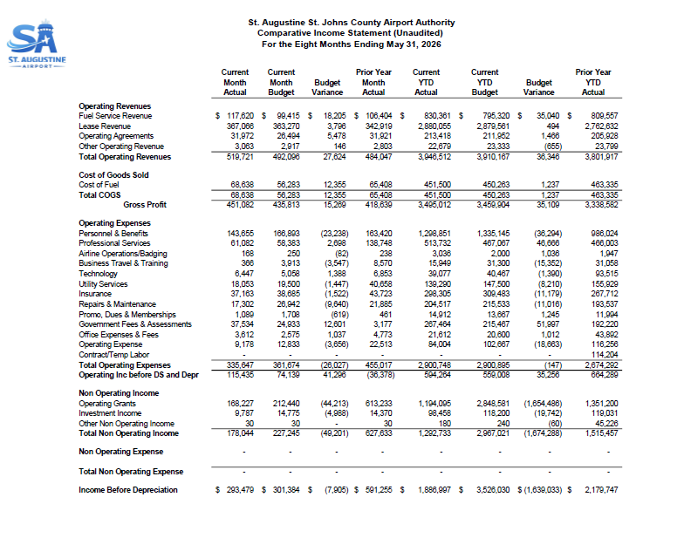

Slide 28
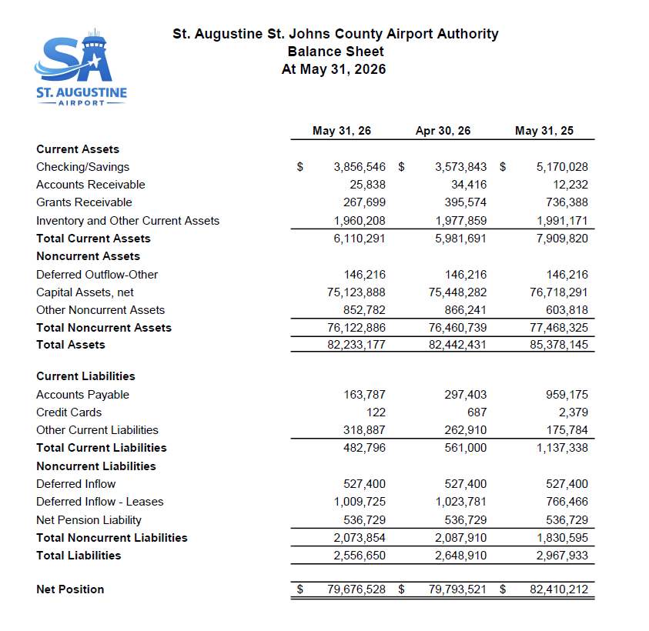

Slide 29
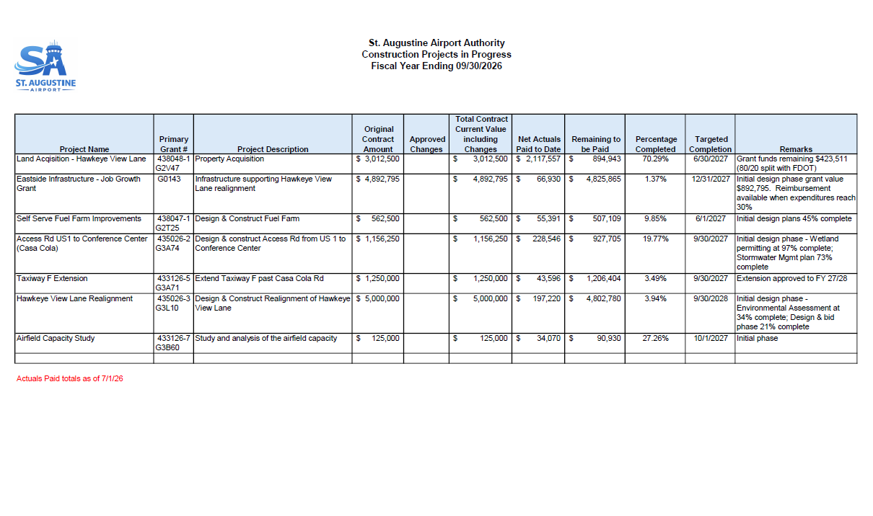

Slide 30
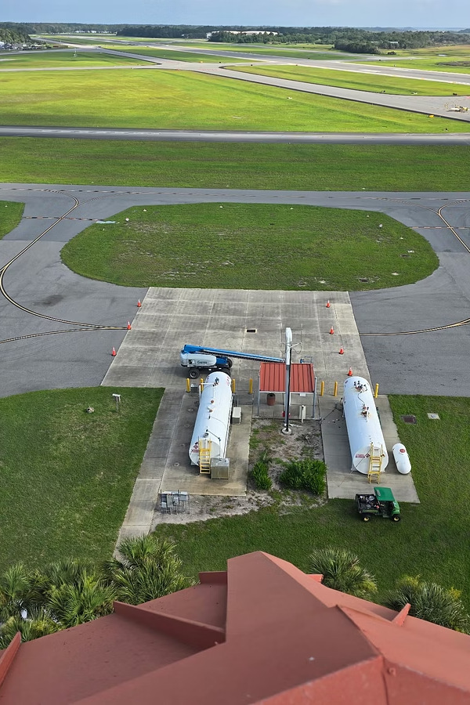
ST. AUGUSTINE AIRPORT · BOARD BRIEFING
Self-Serve Fuel Farm
Replacement Project Update
Presented by Adam Henson, Fuel Safety Supervisor
This briefing orients the Board to the current status of the Self-Serve Fuel Farm Replacement project — including operational impact, funding requirements, and governance implications.
Notes:
Board briefing on the Self-Serve Fuel Farm Replacement project: current status, operational impact, funding requirements, and governance implications.

Slide 31
BRIEFING OVERVIEW
Agenda
This briefing moves from current condition and evidence, through the direction set in July 2026, to the timeline for next steps.
01
02
Current Condition & Evidence
July 2026 Direction
Status of both tanks, leak discovery, and closure progress
Passero deliverables, cost estimates, and project scope
03
04
Timeline & Next Steps
Key Takeaways
Path to operational restoration and temporary tank deployment
Positive developments and Board action items

Slide 32
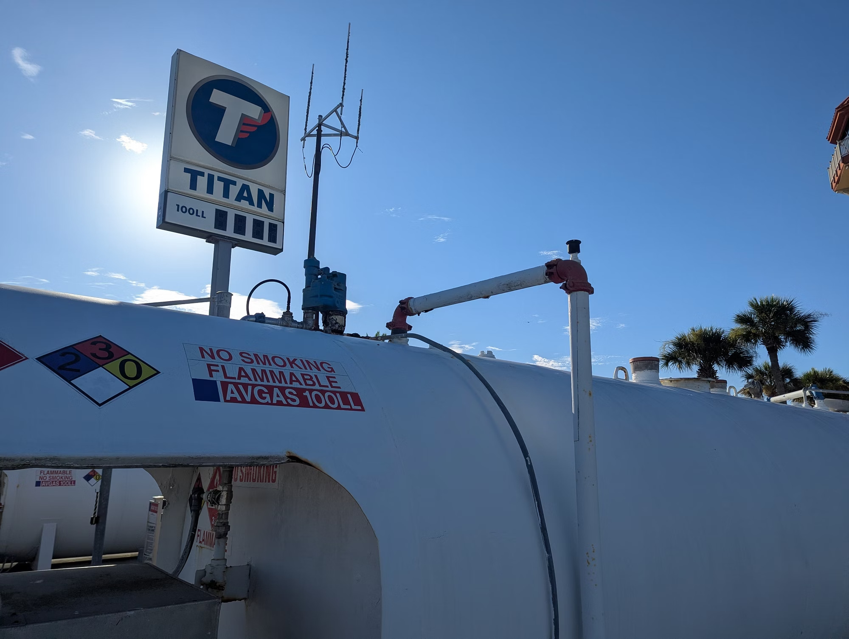


CURRENT CONDITION
Both Tanks Are Out of Service
Tank 1 — Closed July 2025
Extensive corrosion damage led to permanent closure. FL DEP closure process is underway to enable removal from property.
Tank 2 — Recently Failed
A leak was discovered at the primary pump on top of the tank, requiring immediate shutdown. Both tanks are now non-operational.
Tank 2 — AVGAS 100LL self-serve unit
Notes:
Tank 1 was permanently closed in July 2025 after extensive corrosion damage; the FL DEP closure process is underway. Tank 2 recently failed — a leak at the primary pump required immediate shutdown. Both tanks are now non-operational.

Slide 33

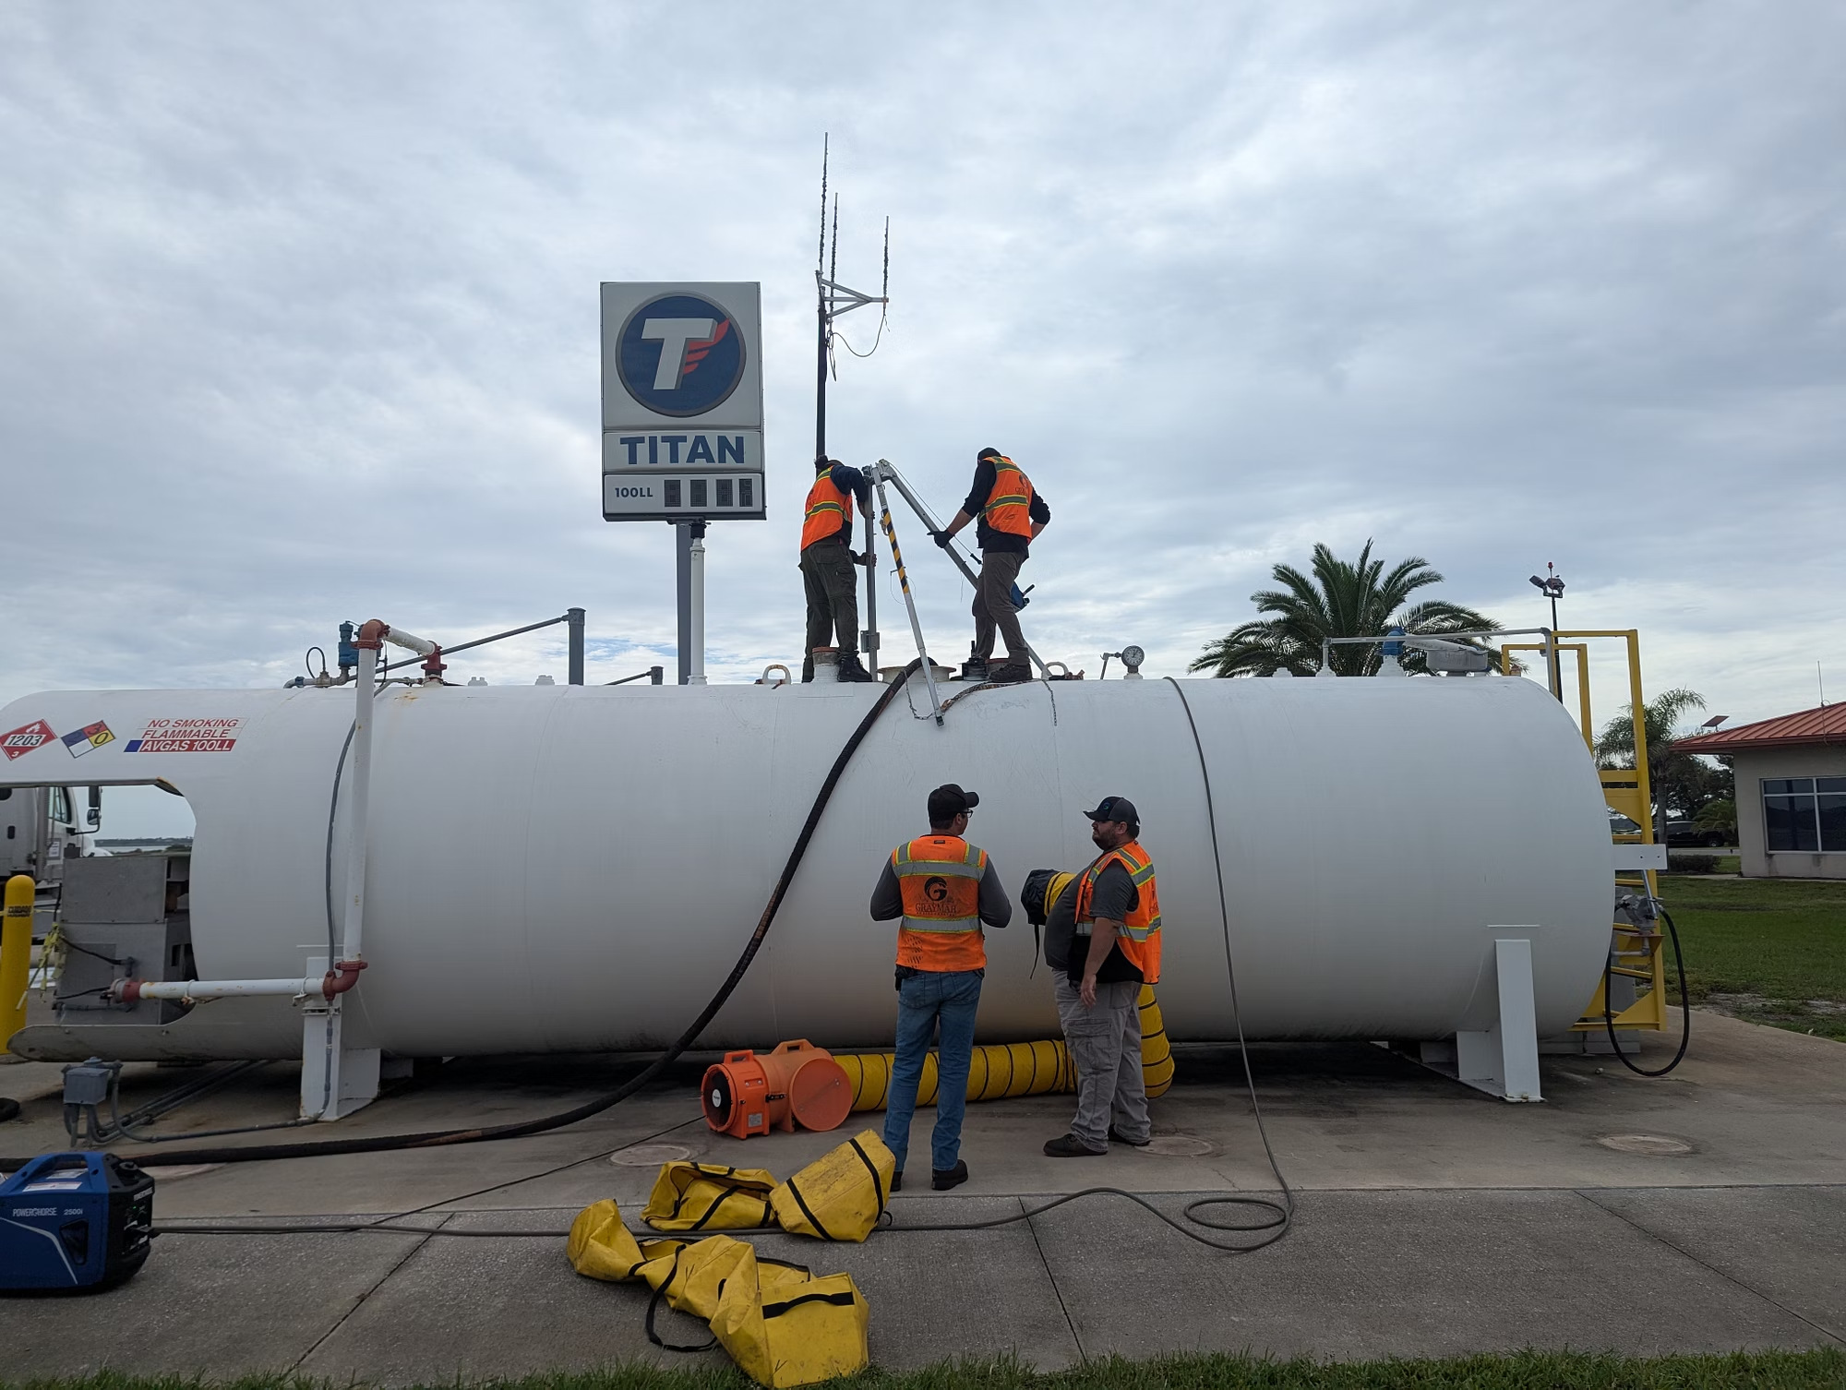
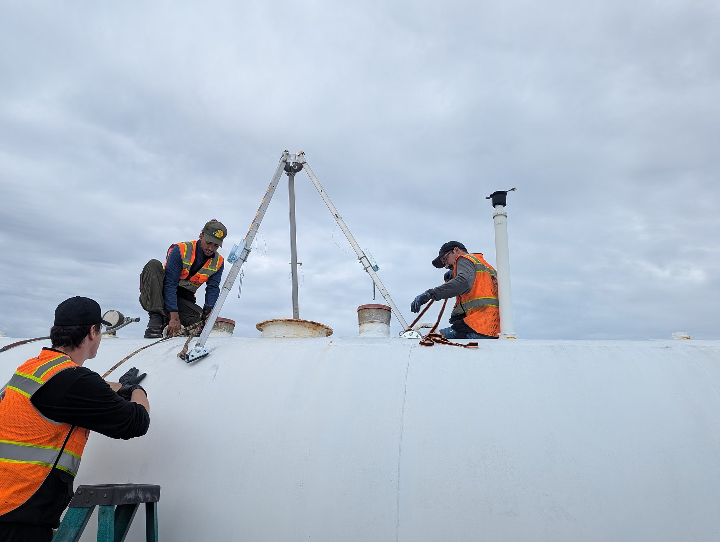
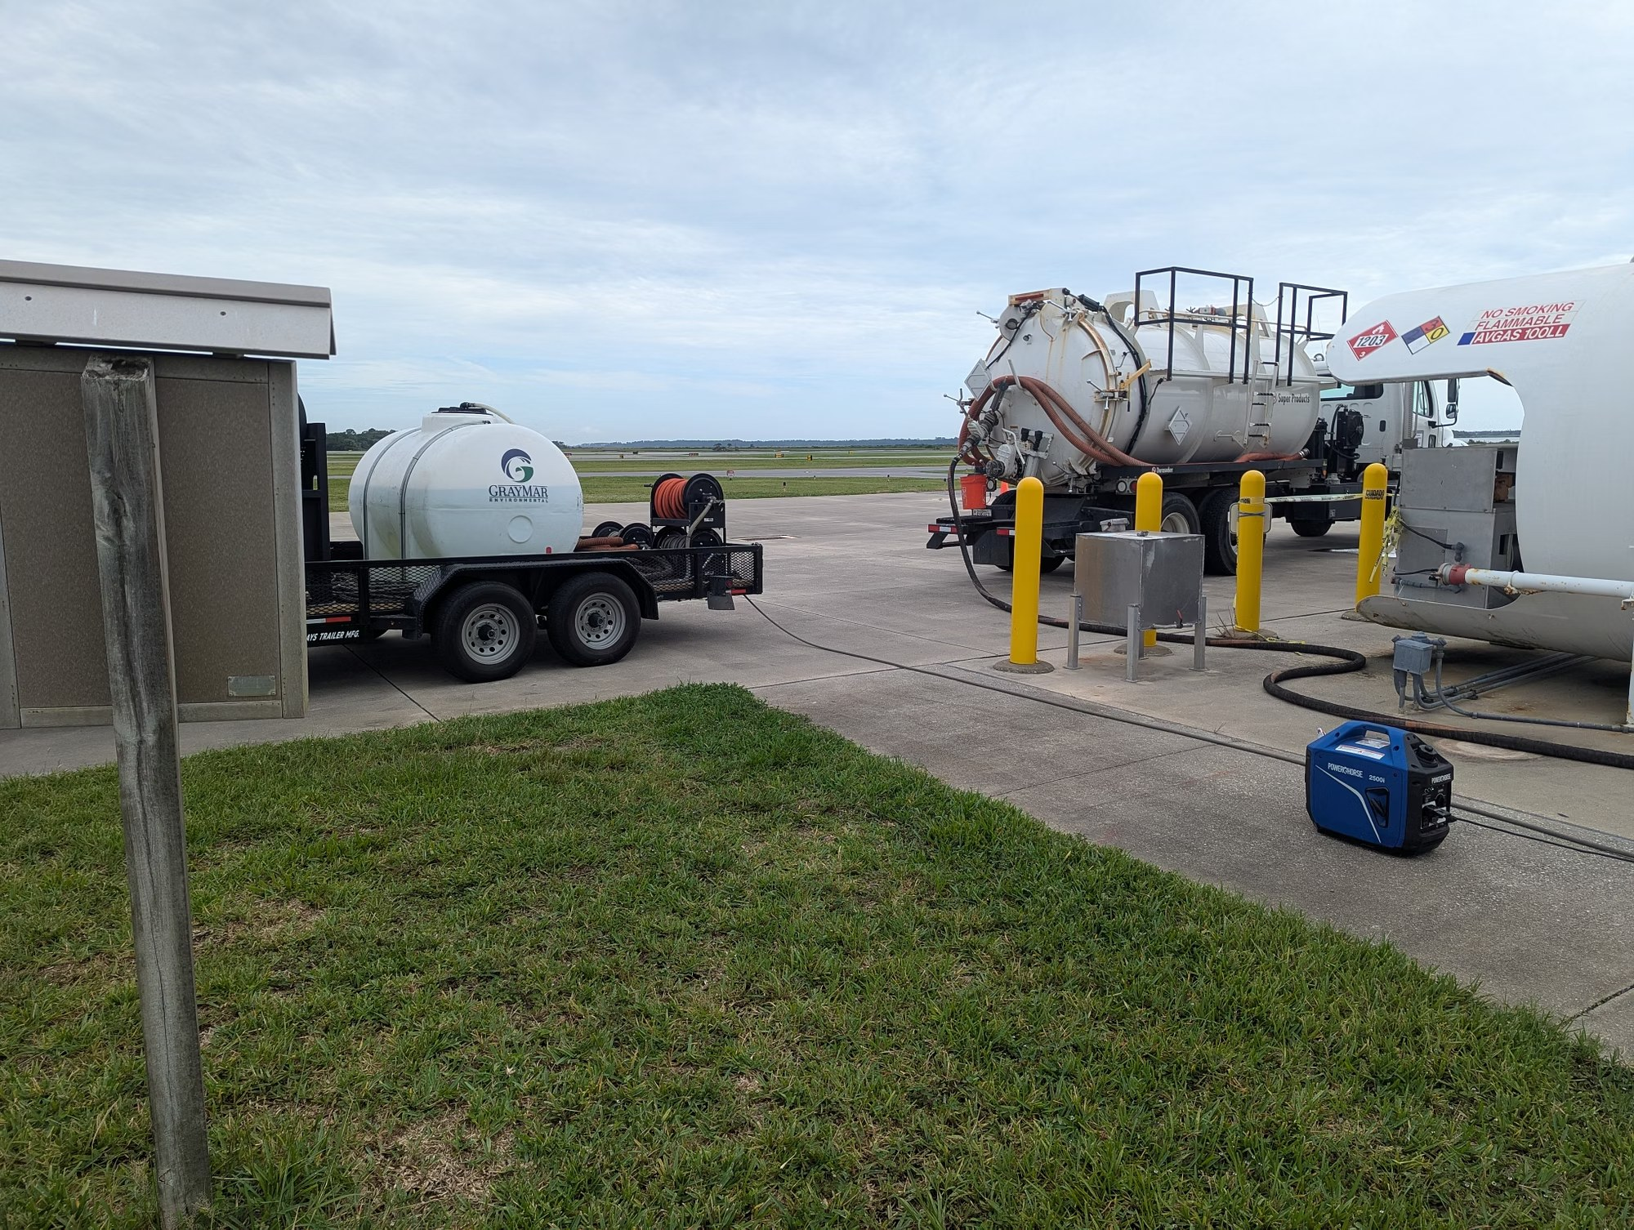
CLOSURE PROGRESS
Tank 1 Removal Underway
Stage 1 Complete
Next Steps
Approved technical vendor to drain and remove external components
Closure inspection preparation
30-day notice to FL DEP prior to physical removal
Site cleared for temporary tank installation
GrayMar Environmental Services completed fuel removal and proper disposal yesterday — the first required step in the FL DEP closure process.
Crew begins fuel removal at Tank 1
Technicians work atop the tank
Fuel transferred for proper disposal
Notes:
GrayMar Environmental Services completed fuel removal and proper disposal — the first required step in the FL DEP closure process. Next: approved technical vendor drains and removes external components, closure inspection prep, 30-day notice to FL DEP prior to physical removal, and site cleared for temporary tank installation.

Slide 34



JULY 2026 DIRECTION
Passero Deliverables: July 8–10
1
2
3
July 8
July 9
July 10
→
→
Phase 1 bid documents provided by Passero
Mechanical plans delivered for one 12,000-gallon replacement self-serve tank system
Opinion of Probable Cost issued: $275,000 per tank (equipment only — excludes installation, testing, certification, and registration)
Notes:
Passero deliverables July 8-10: Phase 1 bid documents; mechanical plans for one 12,000-gallon replacement self-serve tank system; and an Opinion of Probable Cost of $275,000 per tank for equipment only, excluding installation, testing, certification, and registration.

Slide 35



PROJECT SCOPE
Two Independent 12,000-Gallon Systems
The project has been refocused from a single 20,000-gallon tank to two independent 12,000-gallon systems — a decision that enables immediate action and preserves long-term operational resilience.
PHASE 1
PHASE 2
Replace Tank 1
Replace Tank 2
→
Install first 12,000-gallon self-serve tank system as the Tank 1 replacement.
Remove Tank 2, install a temporary self-serve tank, then install the second 12,000-gallon system.
Both phases maintain system redundancy.
Notes:
Scope refocused from a single 20,000-gallon tank to two independent 12,000-gallon systems, enabling immediate action and preserving long-term operational resilience. Phase 1 replaces Tank 1; Phase 2 removes Tank 2, installs a temporary self-serve tank in the interim, then installs the second system. Both phases maintain system redundancy.

Slide 36

FINANCIAL OVERVIEW
Estimated Cost to Restore Operations
What's Included
The $275,000 per tank estimate covers equipment procurement only. Additional costs will be required for:
Full installation and civil work
Start-up testing and commissioning
FL DEP certification and registration
Temporary tank procurement and setup
Board approval of supplemental funding will be required at a later date.
Total project cost will exceed $550,000 once installation, testing, and ancillary costs are included.
Notes:
The $275,000 per tank Opinion of Probable Cost covers equipment procurement only. Additional costs: full installation and civil work, start-up testing and commissioning, FL DEP certification and registration, and temporary tank procurement and setup. Total project cost will exceed $550,000; Board approval of supplemental funding will be required at a later date.

Slide 37



GOOD NEWS
Three Positive Developments
Tenant Relief Secured
Temporary System Found
Direct-to-Bid Pathway
Atlantic Aviation offered Avgas discounts to tenants, helping ease the financial impact of the self-serve facility closure.
Despite being advised a temporary self-serve solution was unlikely to be found, the airport team successfully sourced and secured one.
Refocusing to two 12,000-gallon systems enables the project to move straight to bid, accelerating the timeline and maintaining future redundancy.
Notes:
Three positive developments: Atlantic Aviation offered Avgas discounts to tenants; the airport team sourced and secured a temporary self-serve system despite advice that one was unlikely to be found; and the two-system approach allows the project to move straight to bid.

Slide 38
KEY TAKEAWAYS
Where the Project Stands
1
Both tanks are out of service
2
Tank 1 removal is underway
Tank 1 closed July 2025; Tank 2 shut down after a pump leak.
Fuel removal complete; FL DEP closure process continues.
3
Scope set: two 12,000-gallon systems
4
Funding action will return to the Board
Direct-to-bid pathway with a temporary tank in the interim.
Equipment is $275,000 per tank; total will exceed $550,000.
Presented by Adam Henson, Fuel Safety Supervisor · St. Augustine Airport
Notes:
Summary of the briefing. Board action item: approval of supplemental funding will be required at a later date, once installation, testing, and ancillary costs are defined.

Slide 39
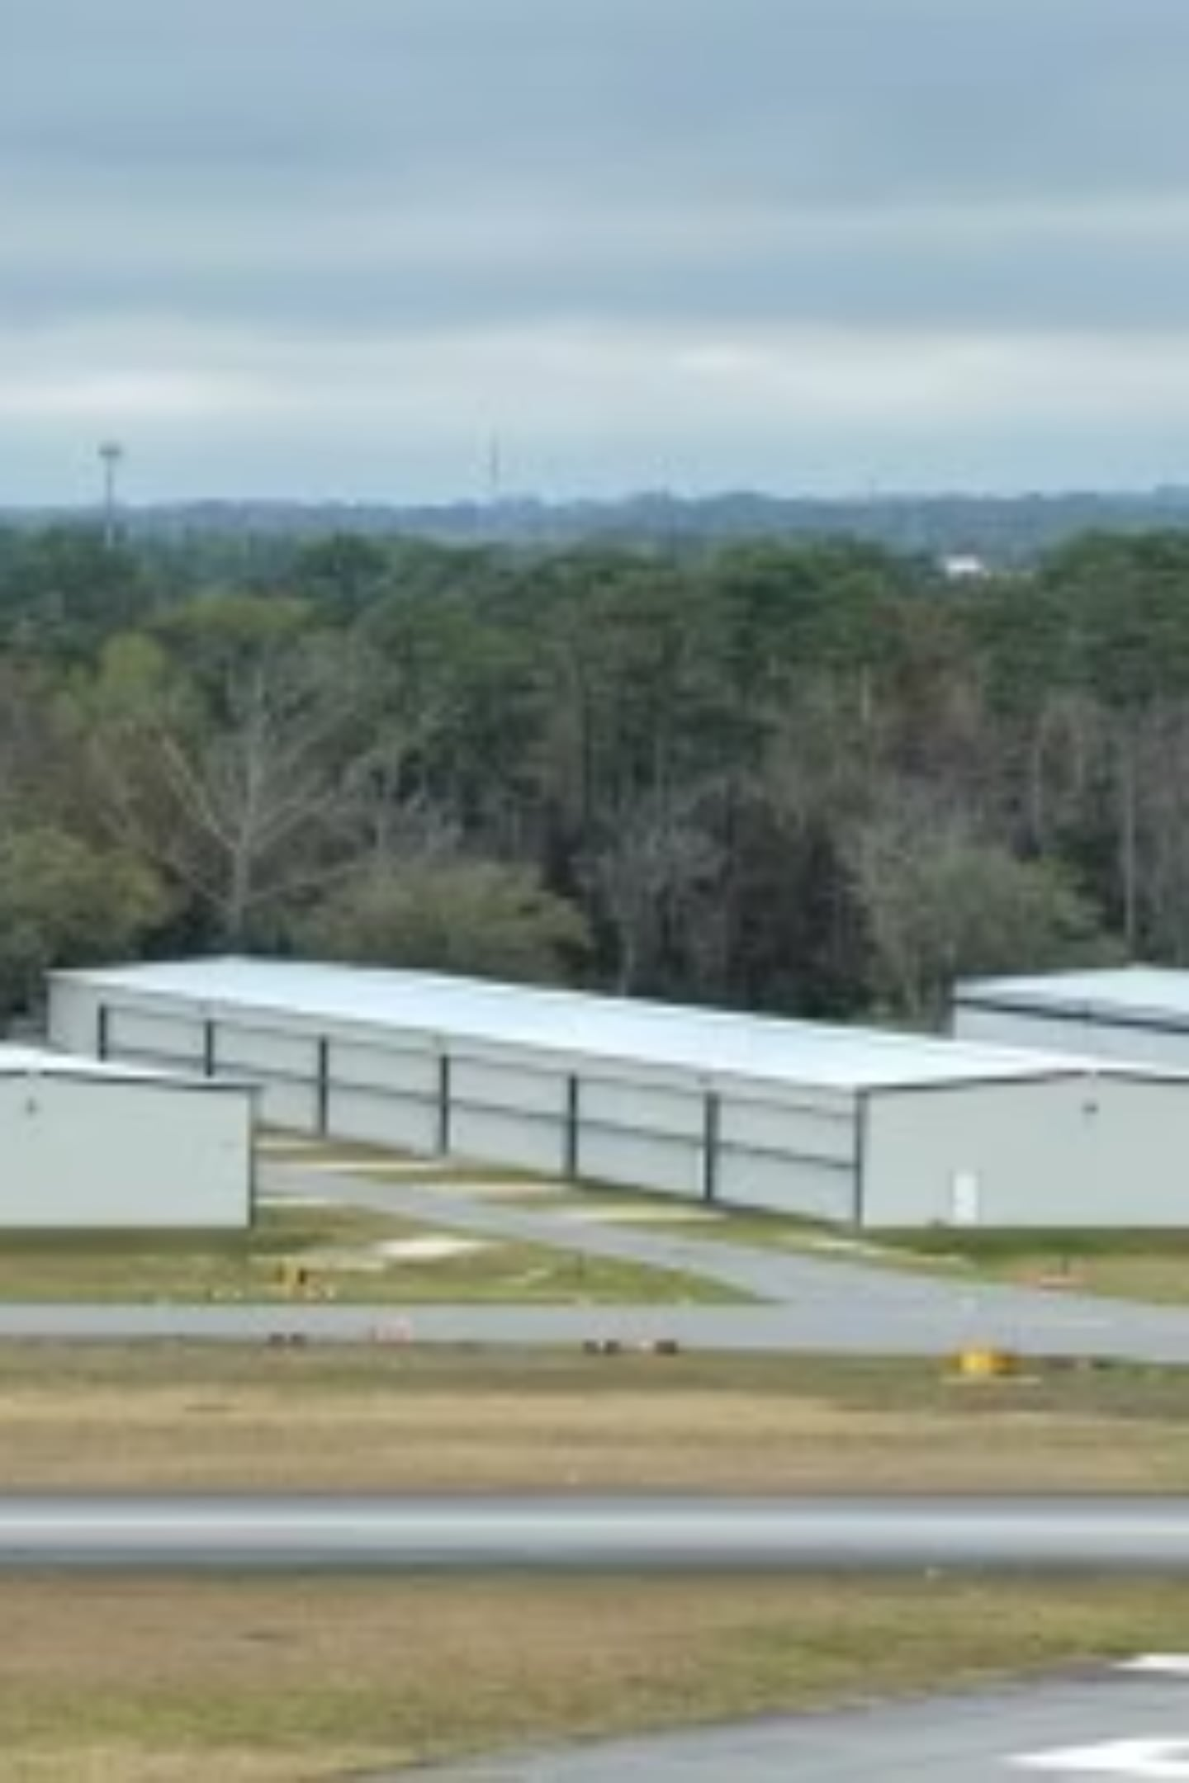
T-Hangar Maintenance & Asset Management Program
Protecting our facilities. Planning for the future. Investing maintenance funds back into airport-owned infrastructure.

Slide 40
PROGRAM PURPOSE
Why This Program Exists
Protect & Extend
Improve Safety
Preserve hangar facilities and extend their useful life
Enhance reliability and safety for all tenants
Reduce Failures
Reinvest Funds
Proactive maintenance prevents unexpected breakdowns
Maintenance dollars stay in airport-owned facilities

Slide 41

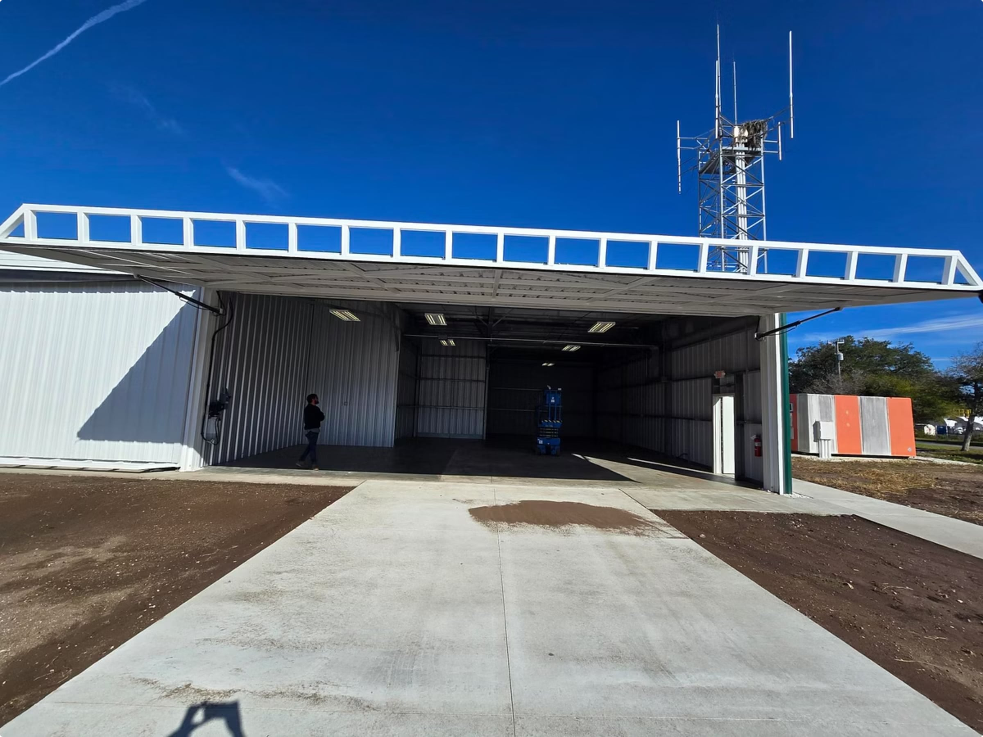
RECENT ACCOMPLISHMENTS
Recent Maintenance & Repairs
Hydraulic Systems
Replaced multiple door cylinders and hydraulic lines
Lighting Upgrades
Repairs and upgrades across multiple hangars
Tenant Requests
Responsive service to all submitted maintenance requests

Slide 42

PREVENTIVE MAINTENANCE
Our Maintenance Approach
Instead of waiting for equipment to fail, we are implementing a structured preventive maintenance program.
Goal
Identify issues early, reduce emergency repairs, and
extend the life of airport facilities.

Slide 43
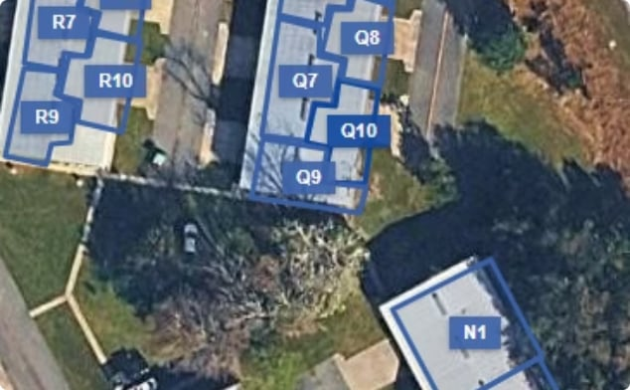
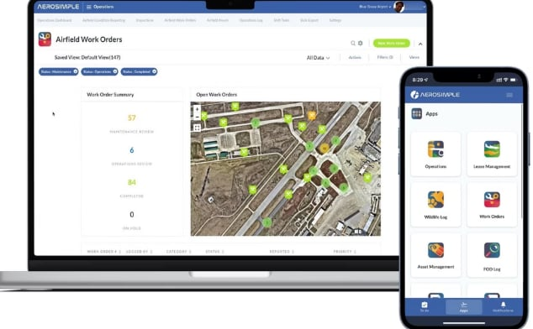

LOOKING AHEAD
Long-Term Hangar Asset Management
Track Every Hangar
Schedule & Forecast
Improve Budget Planning
Document condition, repairs, and maintenance history for each facility
Plan preventive work and forecast major repairs before they become emergencies
Prioritize projects by condition and need to maximize facility lifespan

Slide 44

From Reactive to Proactive
Our goal is to ensure maintenance funds are invested wisely — protecting the airport's facilities for years to come.
Today
Tomorrow
Preserve hangars, respond to tenants, prevent failures
Track conditions, forecast repairs, plan budgets
Future
Maximize useful life of all airport-owned facilities

Slide 45


Passero Associates
Hawkeye View Roadway Relocation & Self-Serve Fuel Update
St. Johns County Airport Authority
Regular Meeting July 15, 2026

Slide 46
Outline
Hawkeye View Roadway Relocation
  Update
  Action Item for Approval
Self Serve Fuel Farm Project Update

Slide 47
Hawkeye Roadway Relocation
(East Terminal Drive)
Project Status Update
  30% Design Completion Reached June 30.
  60% Design Milestone Scheduled for August 7.
  Permit Applications to SJC & SJRWMD Scheduled at 60% (August 7).
  Rezoning of 22.7 Acre Gun Club Parcel Acquired in 2024.
    SJC Planning & Zoning Agency Hearing Scheduled for July 23rd.
    SJC BOCC Hearing Scheduled for August 18th.
  90% Design Milestone Scheduled for September 21
  100% Design Milestone Scheduled for October 26
  Bidding Scheduled for November 9 through December 15

Slide 48
Hawkeye Roadway Relocation
(East Terminal Drive)
Additional Services – Wetland Permitting & Mitigation
  (Graphics on Upcoming Slides)
  Original Design Contract planned for Roadway Right of Way Only
  Wetland Impact and Mitigation Footprint Expanded so not to create unnecessary temporary measures to maintain hydraulic connection between Intracoastal and Upstream Wetlands (temp. storm pipes).
  SJC Land Development code revised in late 2025 – Early Clearing & Grading allowed only after submitting full site design plans (Civil and Landscape) for future development.
  Enhanced Tree Preservation added to project in effort to lessen impacts to old growth forest, and to aid in meeting SJC tree mitigation requirements.

Slide 49
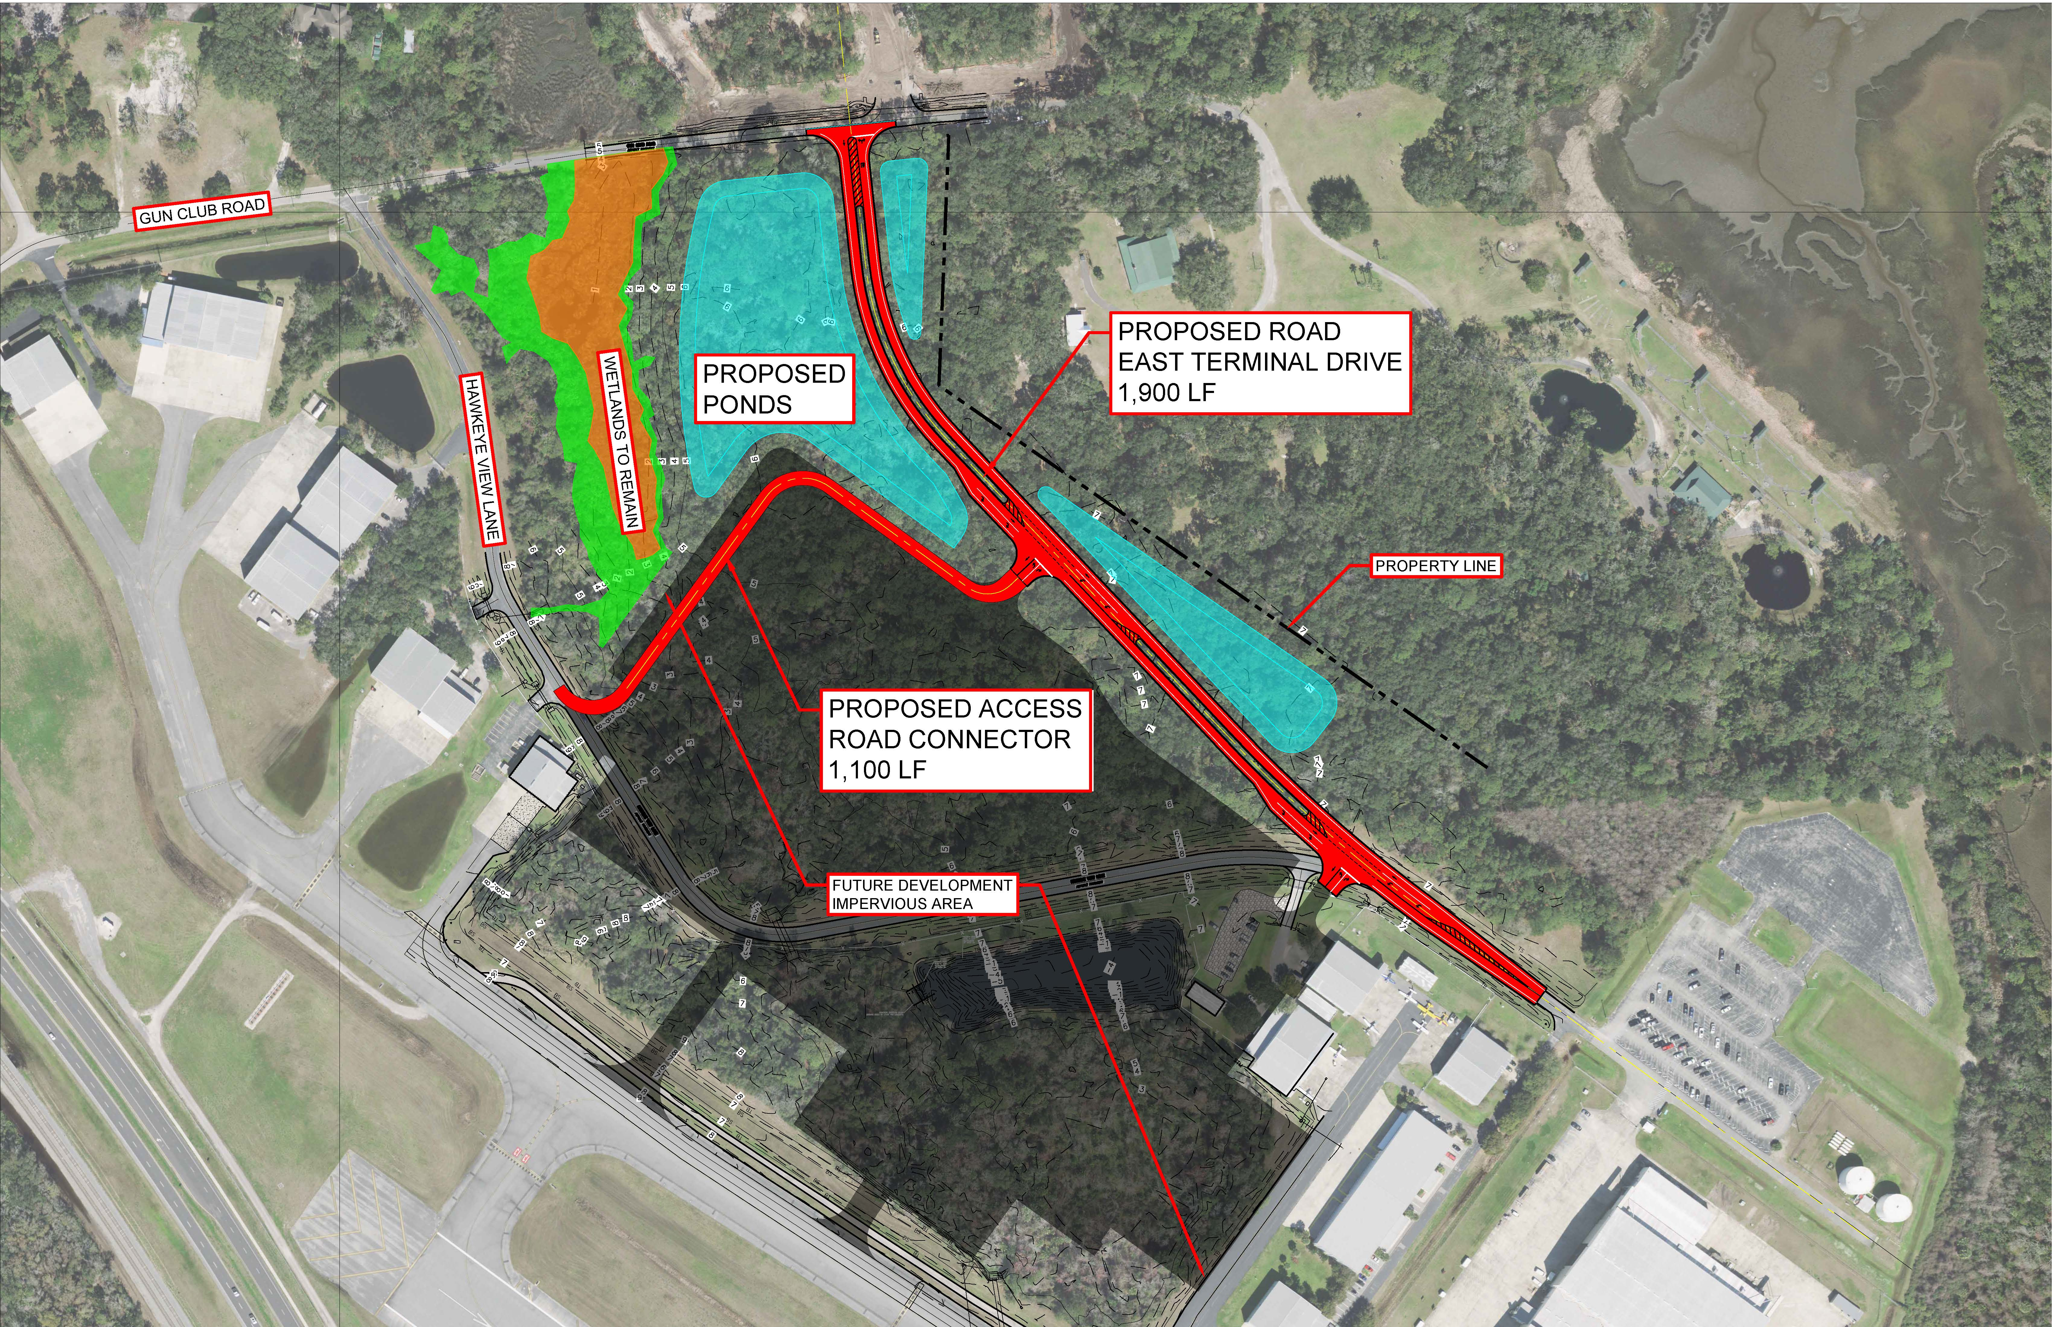
Hawkeye Roadway Relocation –
Original Project Sketch

Slide 50
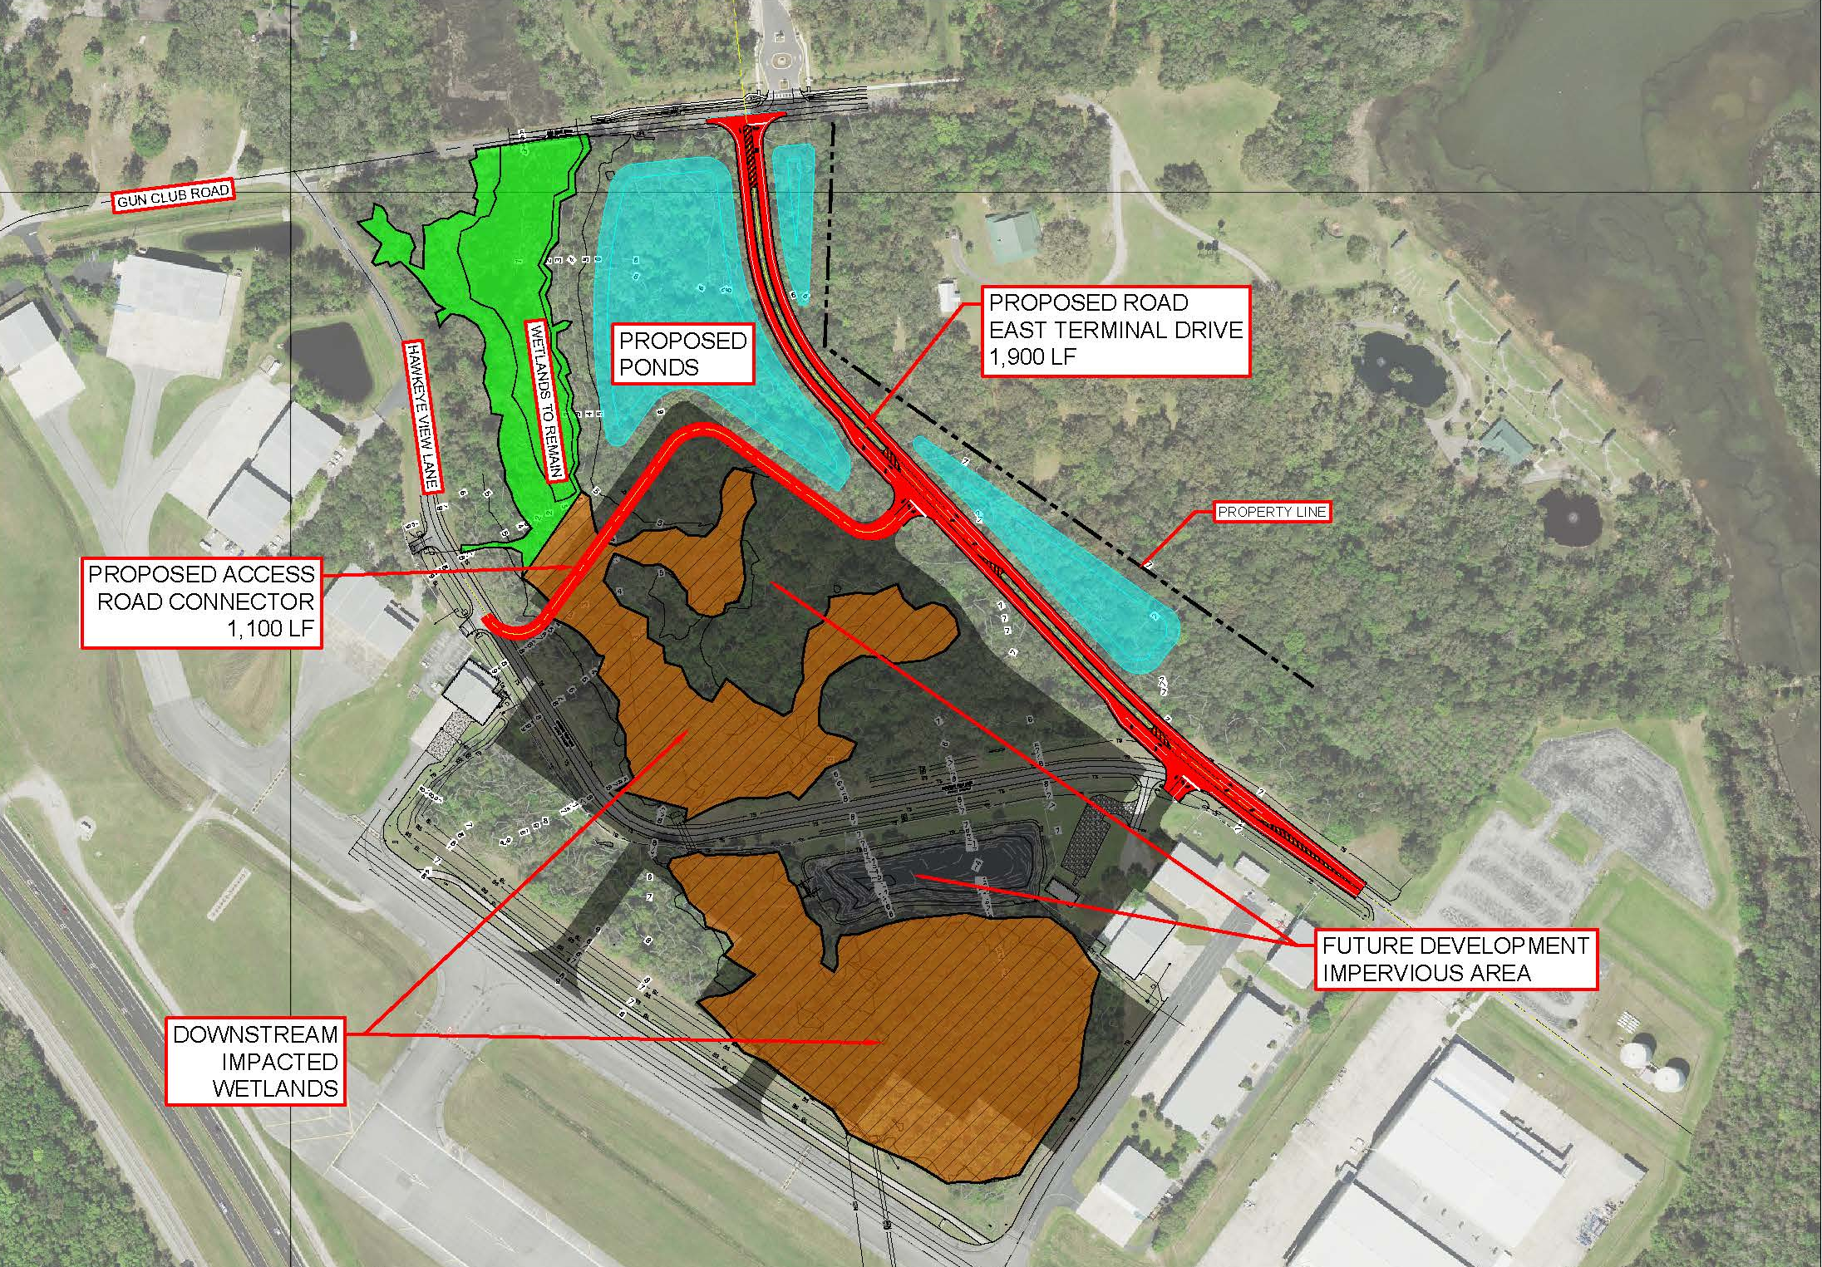
Hawkeye Roadway Relocation – Wetland Impact

Slide 51
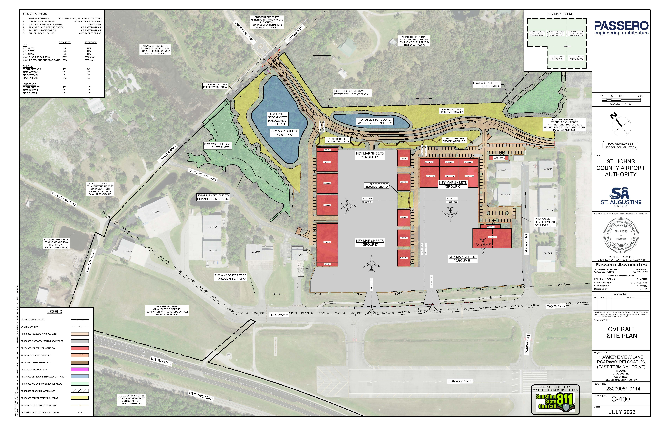
Hawkeye Roadway Relocation –
Site Design to Support Clearing & Filling Wetlands
Note: Concept Site Plan Hangar Layout Shown. Exact Configuration can be modified with future Hangar Design / Permitting
GEOMETRIC LAYOUT,GRADING, DRAINAGE, UTILITY CONNECTIONS, LANDCAPING PLANS FOR HANGAR FACLITY REQUIRED FOR COUNTY PERMITTING TO ALLOW EARLY CLEARING & GRADING

Slide 52
Hawkeye Roadway Relocation –
Enhanced Tree Preservation
RETAINING WALL
BOARDWALK
TREE PRESEVATION AREAS (YELLOW)
Note: Concept Site Plan Hangar Layout Shown. Exact Configuration can be modified with future Hangar Design / Permitting

Slide 53
Hawkeye Roadway Relocation
(East Terminal Drive)
$9.65M Federal Appropriation & FAA Coordination
  Funding Administered by FAA; therefore, FAA grant eligibility & procedural requirements apply
  1st Step is Environmental Clearance – Environmental Assessment in Process
  Goal is to have funding available to support Infrastructure Development construction in 2027 – more clearing, filling, & phase 1 infrastructure possible
  Meeting held with FAA on July 7 to discuss project scope and schedule
    FAA agrees that proposed infrastructure (roads, taxiways, utilities, stormwater facilities / drainage) are grant eligible items.
    Current point still under review is WHEN a grant could be written. No commitment YET to execute a grant in 2027; contingent upon FAA review of Environmental Assessment.
    If no grant in 2027, then it would have to come in 2028; which is not in line with the Phase 1 Infrastructure Schedule
    Follow Up Meeting with FAA scheduled for September 10th. FY 2027 begins October 1st.

Slide 54
Hawkeye Roadway Relocation –
Additional Services
Passero Additional Services Contract Proposed
  Additional Wetland Permitting and Mitigation (Environmental Services)
  Additional Site Design to support Wetland Permitting and Mitigation and to support County permitting requirements for Early Clearing & Grading (Civil & Landscape Disciplines)
  Administer permitting process with SJC to Rezone 22.74 Acre parcel acquired from Gun Club in 2024
  Additional Tree Preservation efforts (Civil, Structural, Landscape Disciplines)
  Proposed Additional Fee - $109,110
Board Approval needed to keep progressing design per current schedule.
Question related to this item?

Slide 55
Self-Serve Fuel Project Status Update
1st Bid – Fuel System Equipment Procurement
  One or Two 12,000 GAL AvGas Tank Systems (Equipment only)
  Advertised for Bid July 10 (21-Day Bid Period)
  Open Bids July 31
2nd Bid – Installation & Any Sitework Requirements
  Design Plans for 2nd bid to be finalized after 1st Bid is opened.
  2nd Bid and preparatory sitework for tank(s) installation to occur while tanks are being fabricated.
Question related to this item?

Slide 56
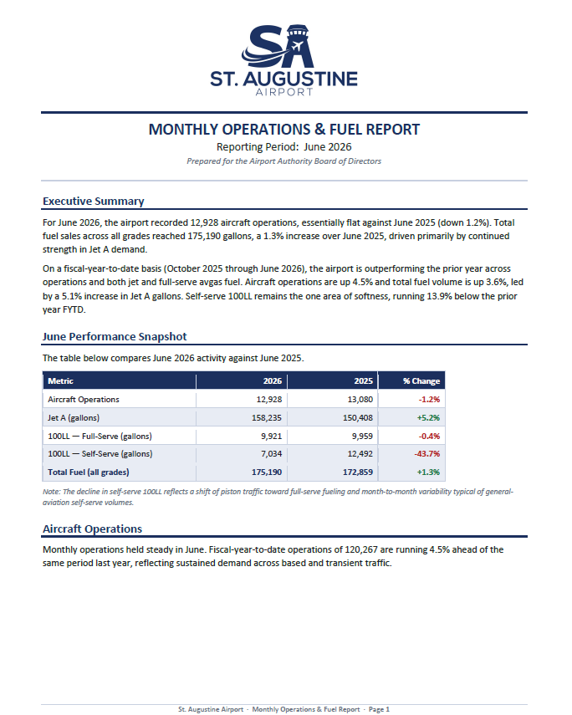

Slide 57
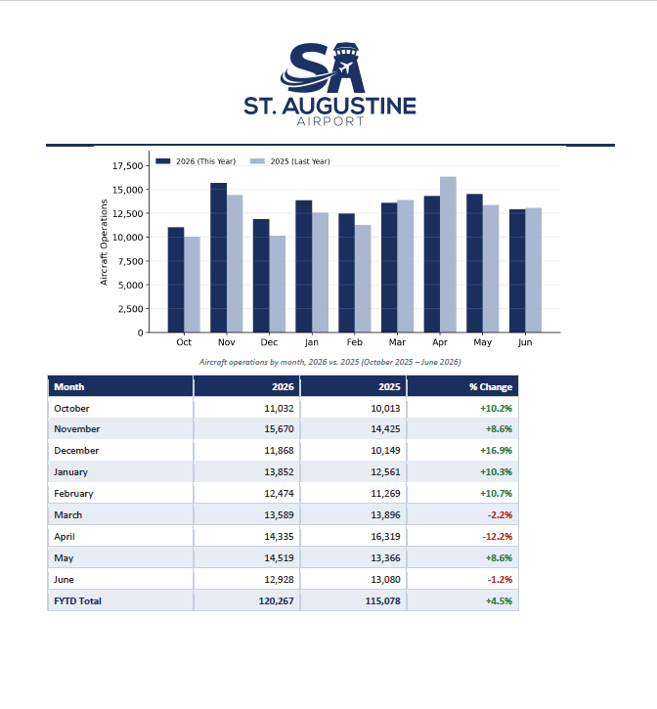

Slide 58
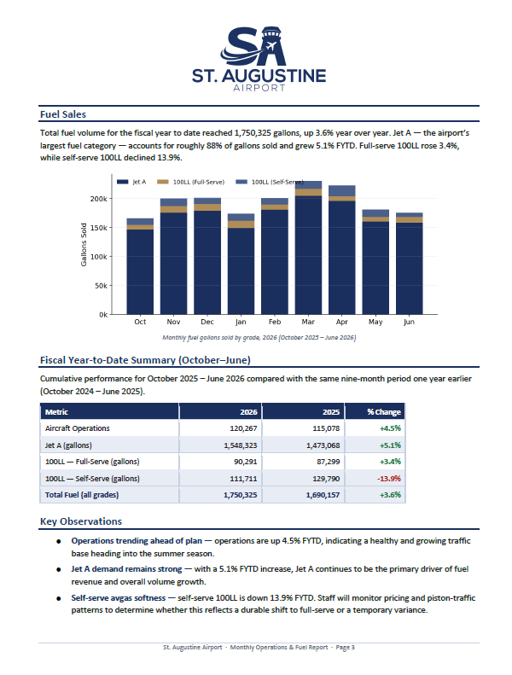

Slide 59


BOARD MEETING
Staff Reports
Deputy General Counsel
Jeffrey Kempf
Aviation Attorney
Chad Roberts
Notes:
Staff Reports — presented by Jeffrey Kempf, Deputy General Counsel, followed by Chad Roberts, Aviation Attorney.

Slide 60

BOARD MEETING
Board Member Comments
Mr. Nick Primrose
Chairman
Mr. Mario Dipola
Vice Chair
Ms. Michelle Cash-Chapman
Secretary/Treasurer
Mr. Jerry Dedge
Board Member
Mr. Daniel Bean
Board Member
Notes:
Board Member Comments — Chairman Nick Primrose, Vice Chair Mario Dipola, Secretary/Treasurer Michelle Cash-Chapman, Jerry Dedge, and Daniel Bean.

Slide 61
BOARD MEETING
Next Meetings
Audit/Budget Committee Meeting
8:00 AM
Wednesday, 12 August 2026 · Airport Conference Center
Regular Board Meeting
9:00 AM
Wednesday, 12 August 2026 · Airport Conference Center
Adjournment
Notes:
Next meetings: Audit/Budget Committee Meeting, Wednesday, 12 August 2026 at 8:00 AM, Airport Conference Center; Regular Board Meeting, Wednesday, 12 August 2026 at 9:00 AM, Airport Conference Center. Adjournment.

